Slide 1
Thermodynamically compatible models of multiphase compressible flows
Romenski E.
Sobolev Institute of Mathematics

Slide 2
Class of thermodynamically compatible
systems of hyperbolic conservation laws
• All governing differential equations of the system are written in a conservative form
and the system can be transformed to a symmetric hyperbolic form
• Solution to the system satisfied to thermodynamic laws
(conservation of energy and entropy growth)
• Many well-posed systems of mathematical physics and continuum mechanics
can be written in the form of thermodynamically compatible system.
Examples: gas dynamics, magneto-hydrodynamics, nonlinear and linear elasticity,
electrodynamics of moving media, etc.
________________________________________________________

Slide 3
Symmetric hyperbolic systems
- unknown variables
- Linear symmetric system (Friedrichs 1954)
Hyperbolicity:
eigenvalues of
are real
The Cauchy problem well-posed, i.e. the solution exists and unique
__________________________________________________________________________________
The generalization for nonlinear case which is typical in continuum mechanics:
- quasilinear symmetric system

Slide 4
How to prove the symmetric hyperbolicity for concrete system?
Gas dynamics equations (Euler equations)
Parameters of state:
- density,
- specific volume,
- velocity,
- temperature,
- internal energy,
- entropy
First law of thermodynamics
Independent parameters of state:
Conservation laws
Mass conservation (continuity equation)
Momentum conservation
Energy conservation
Additional entropy conservation law holds

Slide 5
Godunov’s L-q form of Euler equations
___________________________________________
Proof
The following idea appears! (next slide)

Slide 6
Generating potential and variables
①
Let us define variables
and assume that conservative variables are written in the form
Then takes the form
①
and can be written as
The latter gives us expression for the generating potential

Slide 7
L-q formulation of Euler equations
________________________________________________________________________________
Energy conservation law
takes the form

Slide 8
Symmetric form of L-q form of Euler equations
___________________________________________________________________
Quasilinear form
The system is symmetric and hyperbolic if
________________________________________________________________________________________
Internal energy (Equation of state) is a convex function:

Slide 9
Elasticity equations
Moving medium
- Eulerian coordinates
- Lagrangian coordinates at t=0
Velocity
Deformation (stretch and rotation) is characterized by the Deformation Gradient (or Distortion)
We also use the inverse matrix
Compatibility conditions:
kinematics
Steady constraints

Slide 10

Elasticity equations (variational principle)
Lagrangian
$ρ_{0}$=const
- initial density
Minimization gives us
In terms of the velocity and deformation gradient the above equation reads as

Slide 11
Elasticity equations in Lagrangian coordinates
- Piola-Kirchhoff stress tensor
Conservation of energy
For isotropic media energy depends on the three independent invariants of deformation tensor
We usually take the Finger tensor
and as the three invariants one can take

Slide 12
Symmetric form of elasticity equations
Introduce vector of generating variables
in such a way that
- the generating potential
______________________________________________________________________________________
The system is clearly symmetric and hyperbolic if the generating potential M is convex

Slide 13
Elasticity equations in Eulerian coordinates I
Transformation to Eulerian coordinates consists of the transformation of coordinates:
spatial derivatives and time derivative
Compatibility conditions
is a consequence of where is the distortion

Slide 14
Elasticity equations in Eulerian coordinates II
Compatibility conditions
is a consequence of where is the distortion
Density is defined as
- the initial density
Continuity equation (mass conservation law)
- pressure
- shear stress
- internal energy
- internal energy

Slide 15
Elasticity equations (alternative version) in terms of A
- pressure
- shear stress
- internal energy
Equation of state
- Hydrodynamic EOS
- Shear strain energy
- Shear sound velocity
- Deviator of strain tensor
Shear stress is proportional to the strain deviator

Slide 16

Inelastic deformations
Shear stress relaxation
Entropy production
- Relaxation time (can change from $∞$ to 0)
_____________________________________________________________________________________________
Energy conservation law

Slide 17
Unified model of continuum mechanics
corresponds to elastic medium
formal asymptotic expansion
gives us
Navier-Stokes equations for compressible viscous flow
with the viscosity coefficient
allows to model inelastic strain-rate and temperature dependent plastic deformations

Slide 18
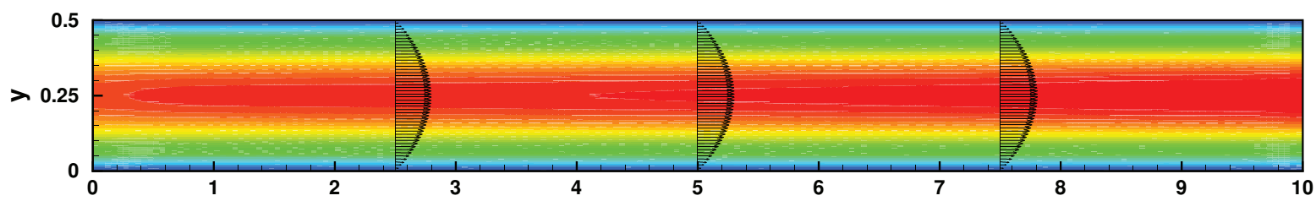
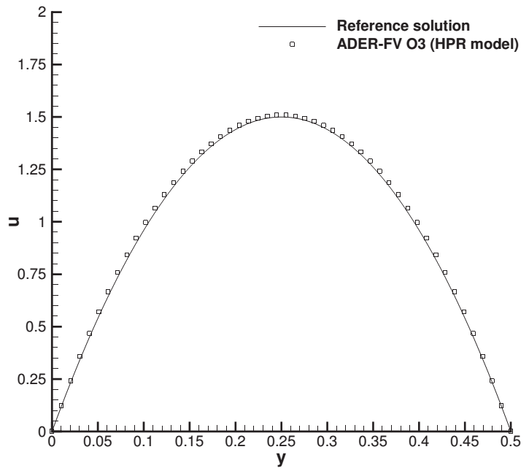
Steady laminar Hagen-Poiseuille flow, Re=50
inflow
(incompressible NS)

Slide 19
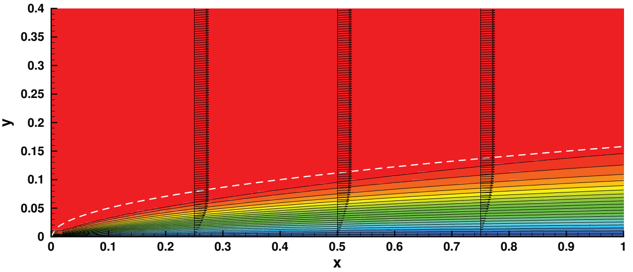
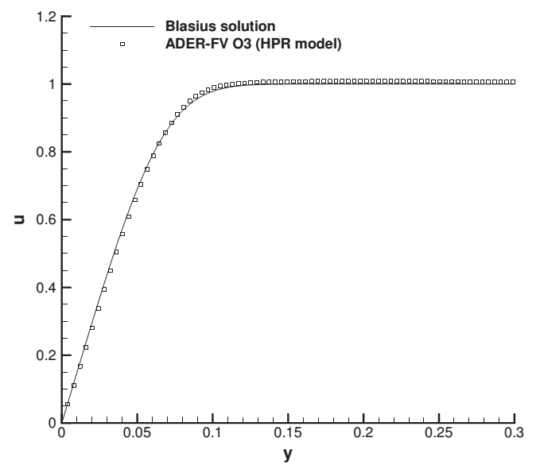
Blasius boundary layer, Re=1000
Velocity contours
Inflow
u=1
x=0.5 cut

Slide 20
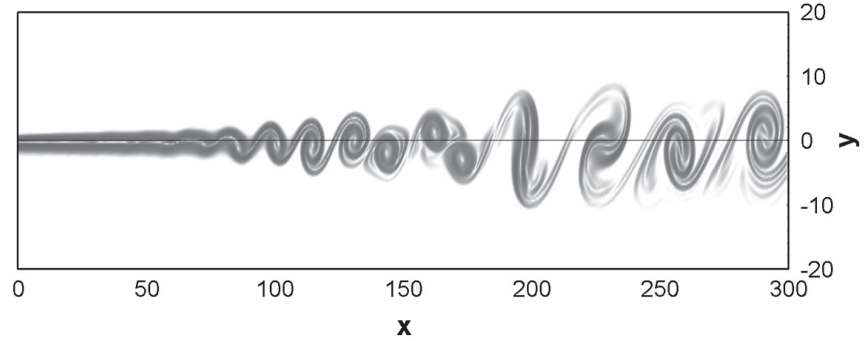
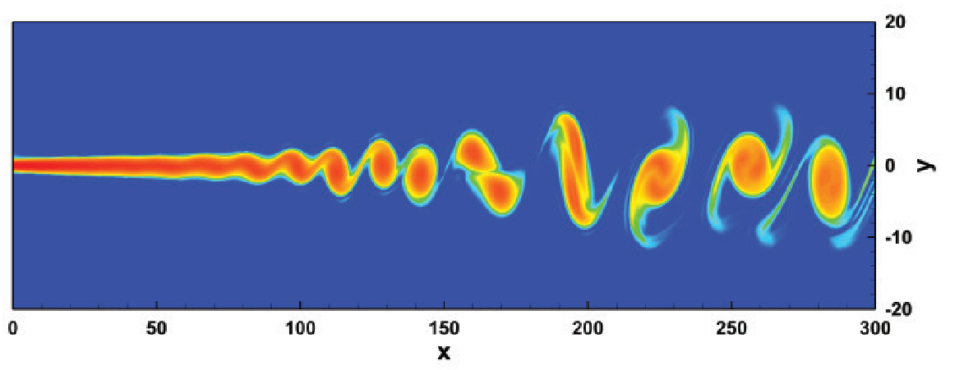
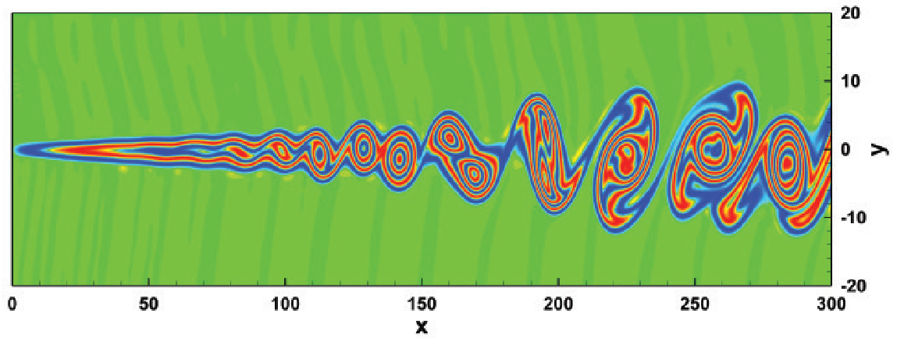
Compressible mixing layer, Re=250
Top: 6th order P_{N}P_{M} scheme
Navier-Stokes model
Dumbser, Zanotti, 2009
Velocity
Vorticity
Hyperbolic model
3rd order ADER-WENO
Dumbser, Enaux, Toro, 2008
A₁₂

Slide 21
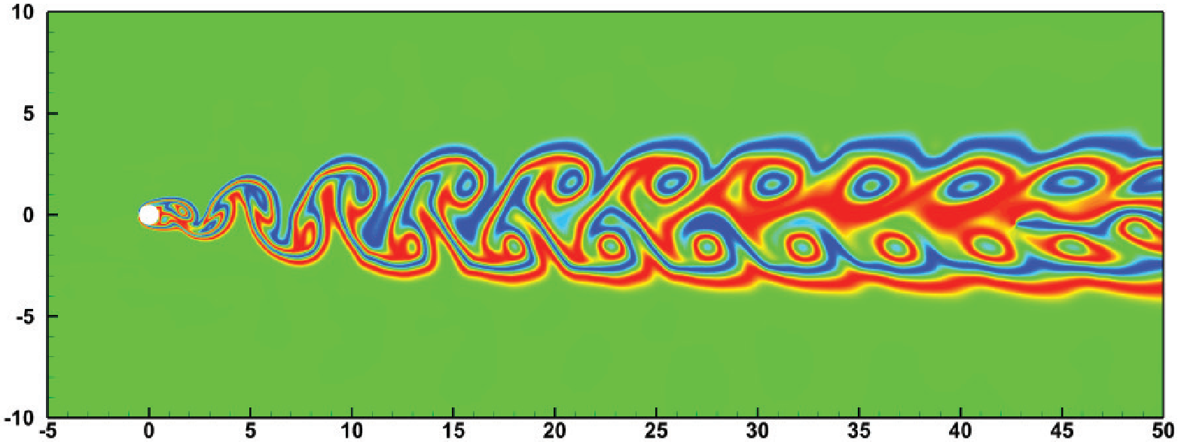
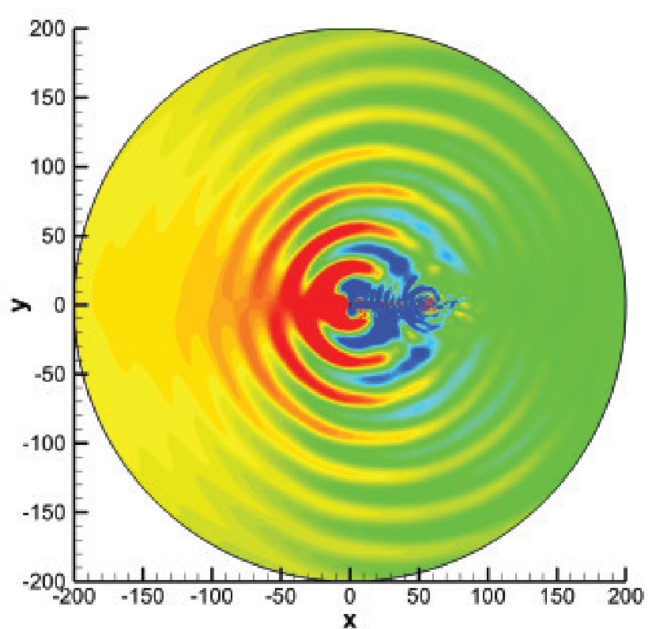

Flow around a circular cylinder, Re=150
A₁₂
Flow
direction
Pressure field.
Full computational
domain
Strouhal number obtained numerically
is in a good agreement with
results reported in the literature

Slide 22
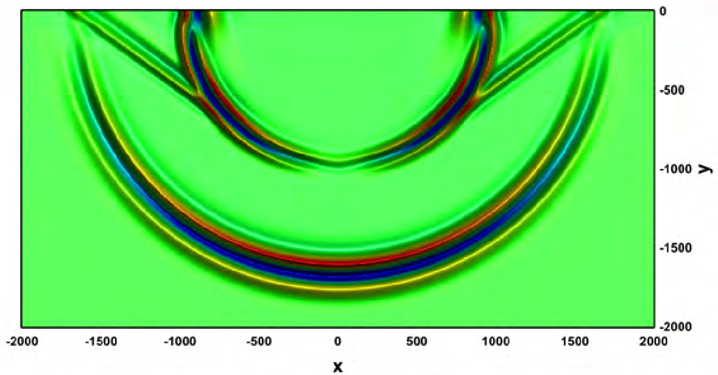
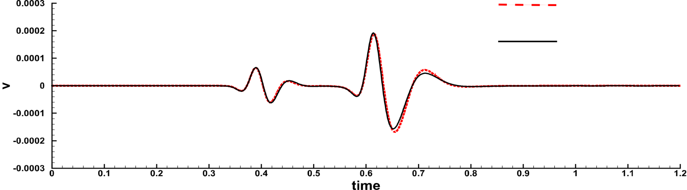
Elasticity: Seismic wave propagation
Linear elasticity
HPR model

Slide 23
Elastic-plastic deformation of hardening material.
Taylor test problem

Slide 24
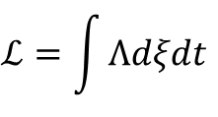
Variational nature of thermodynamically compatible systems
The general thermodynamically compatible system can be derived as the Euler-Lagrange equations obtained by minimization of a Lagrangian
$$ℒ=\int{Λdξdt}$$
where
is the Lagrangian
- Eulerian and Lagrangian coordinates, - potentials
If to introduce variables defined by the potentials as
and define the energy as
then the Euler-Lagrange equations can be formulated as the first order system
supplemented by the compatibility conditions

Slide 25
Variational thermodynamically compatible system
Euler-Lagrange equations are formulated as the first order system supplemented by the compatibility conditions
Conservation of energy
System is symmetric and hyperbolic if U is a convex function
Eulerian HTC system can be obtained from the Lagrangian one
by the cumbersome transformations of coordinates and variables

Slide 26
Class of hyperbolic thermodynamically compatible systems in terms of generalized internal energy
Eulerian HTC system
- generalized internal energy,
- density,
- velocity
- distortion (inverse deformation gradient)
are associated with the electromagnetic field
are associated with the flow of any substance
through an element of the medium
- entropy
Steady conservation laws are
compatible with the evolution equations
Conservation of energy
- the total energy
No dissipation yet!!

Slide 27
Class of hyperbolic thermodynamically compatible systems in terms of generating potential
Legendre transformation
- total energy
Steady conservation laws
Energy conservation law holds
No dissipation yet!!
The system can be written in a symmetric form and is hyperbolic if
is a convex function

Slide 28

Summary
Class of hyperbolic thermodynamically compatible systems
can be formulated from the first principles
Many well-known equations of continuum mechanics belong to this class
New well-posed models of complex physical processes
can be formulated with the use of HTC formalism by:
●proper choice of equations, variables and thermodynamic potential
●introduction of a dissipative source terms
The variety of HTC equations in Eulerian coordinates is wider than that obtained by the minimization of Lagrangian
Open problem: complete description of the class of HTC equations

Slide 29
Continuum characteristics of two-phase flow
Element of two-phase mixture of volume
can be characterized by
• mixture density
• mixture velocity
• mixture energy
Air bubbles in
a water column
• phase volumes
or volume fractions

Slide 30
Two-phase compressible fluid flow models
Development of multiphase flow model
consists of several closely interrelated steps:
1. Introduction a new physical variables in addition to the classical variables
(velocity, density, energy) characterizing two-phase flow.
2. Formulation of new conservation laws for these new variables
in addition to the mass, momentum and energy conservation laws.
3. Introduction a source terms modelling phase interaction and dissipation.
4. Formulation of closing relationships, such as Equation of State
for the mixture and functional dependence of source terms
on the parameters of state

Slide 31
Parameters of state for two-phase flow
We characterize each phase with number by parameters of state:
- phase mass density,
- phase velocity vector,
- phase specific entropy,
Assume that the equation of state (internal energy) is given as
and phase pressures and temperatures can be computed as
Define parameters of state for the mixture as follows:
- mixture mass density
- mass fractions
- mixture velocity
- mixture internal energy

Slide 32
Well-known conservation laws for the mixture
- total mass conservation law
______________________________________________________________
- total momentum
______________________________________________________________
- mixture total energy

Slide 33
Individual phase mass conservation laws
If to ignore phase to phase transformations, then
Mixture mass conservation law
can be obtained
by summation of above equations if to take into account that

Slide 34
Additional parameters of state and balance laws
1
2
total density and phase mass fractions do not change,
but volume fractions can vary
1
2
A balance law for the volume fraction should be introduced
or equivalent
__________________________________________________________________
u
A phase relative motion is characterized
by the relative velocity vector
₂
u₁
An equation for relative velocity should be introduced

Slide 35
Equation for the relative velocity
1st phase mass conservation equation
Can be written in terms of the mixture parameters as
Recalling a coupled structure of thermodynamically compatible system
and assuming
we can formulate the following equation:
If to take in account an interfacial friction

Slide 36
General model. Physical variables for the description of two-phase flow
Independent set of physical variables:
- volume fraction of the 1st phase
- density of the 1st phase
- density of the 2nd phase
- velocity of the 1st phase
- velocity of the 2nd phase
- entropy of the 1st phase
- entropy of the 2nd phase
- heat flux for the 1st phase
- heat flux for the 2nd phase
__________________________________________________________
Additional parameters characterizing the state of the flow:
- volume fraction of the 2nd phase
- total mass density
- phase mass fractions
- mixture velocity
- phase internal energies
- phase pressures
- phase temperatures

Slide 37
Governing equations for compressible two-phase flow with different phase pressures and temperatures
Derivation is based on the extended irreversible thermodynamics laws and thermodynamically compatible system theory.
-- volume fraction balance,
-- 1st phase mass balance law
-- 2nd phase mass balance law
-- total momentum conservation law
-- relative velocity equation
-- phase heat flux balance laws
-- phase entropy balance laws
17 equations, 13 algebraic source terms

Slide 38
SOURCE TERMS
are responsible for phase interaction and dissipation.
Must satisfy requirements
The total energy conservation laws for the mixture holds
The total mixture entropy production is non-negative
The partial phase entropy production is non-negative
Onsager’s principle of dissipative coefficients symmetry holds
_______________________________________________________________________________________
The following source terms are introduced in the governing equations:
phase pressure relaxation to the common value through the process of pressure waves propagation
- phase to phase transition
- interfacial friction force (the Stokes drag force)
- heat flux relaxation to the steady Fourier heat transfer process
- phase temperatures relaxation to the common value through the heat transfer between phases
- phase entropies production caused by phase interaction
38

Slide 39
SOURCE TERMS DEFINITION
|
|
|
|
|
|
|
|
|
|
|
|
|
|
|
|
|
|
|
|
|
|
|
|
Coefficients are connected with
the thermal conductivity and drag ones
-----------------------------------------------
- drag coefficient (interfacial friction)
thermal conductivity
coefficients
----------------------------------------------
The total entropy production
is nonnegative

Slide 40
Single temperature model with phase transition
Governing equations:
Pressure relaxation
Phase transition
Here
Equations are written in a conservative form, can be transformed to the
symmetric system and hyperbolic

Slide 41
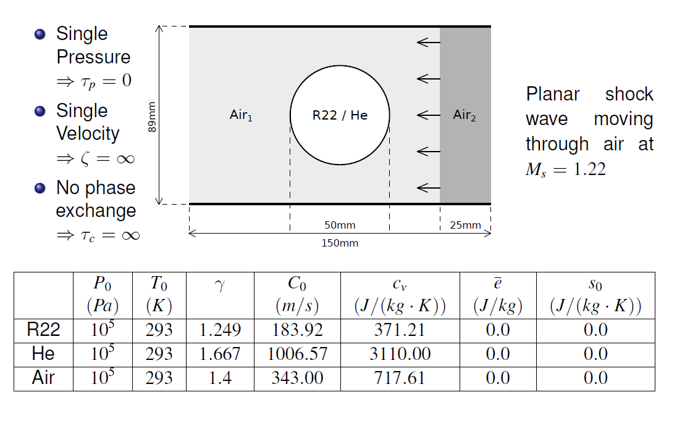
Shock-bubble interaction problem

Slide 42
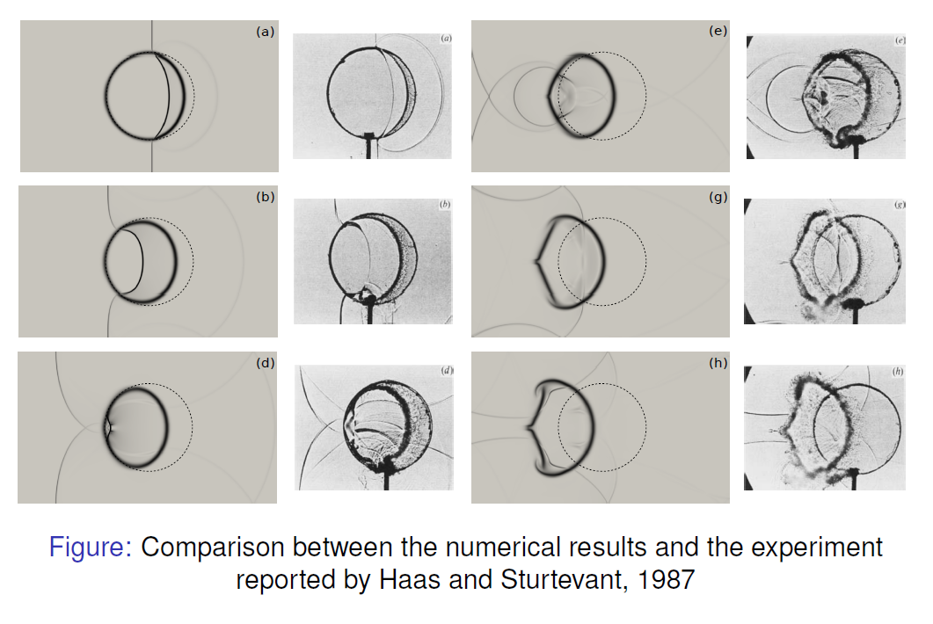
Shock-bubble interaction problem for Freon R22

Slide 43
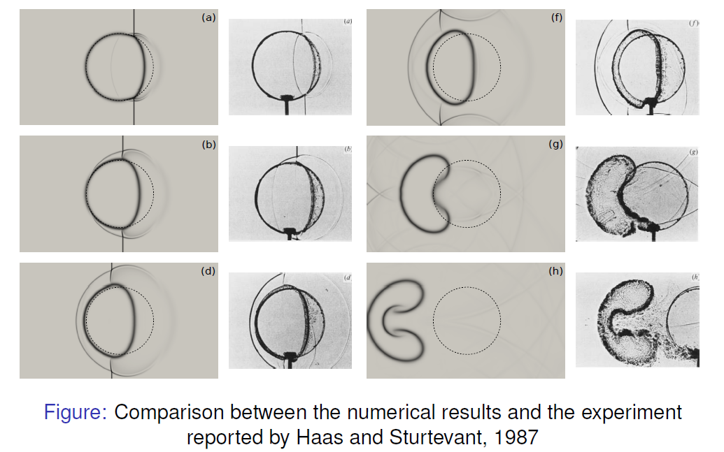
Shock-bubble interaction problem for Helium

Slide 44
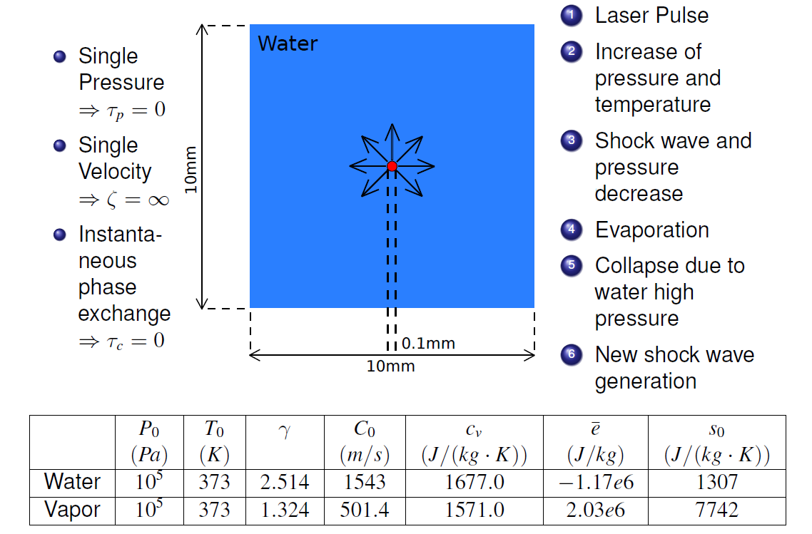
Laser induced cavitation problem

Slide 45
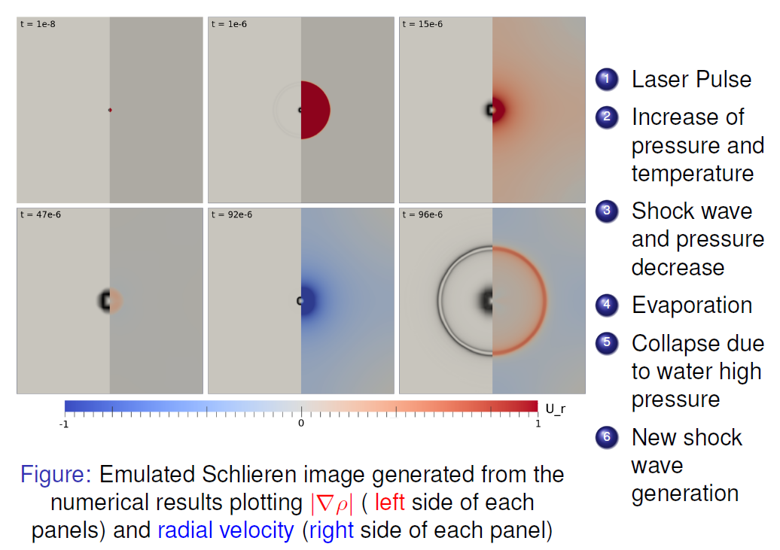
Laser induced cavitation problem numerical results

Slide 46
Thermodynamically compatible conservative multiphase flow model
Single entropy approximation
The -phase mixture with phase parameters
- volume fractions
- phase densities
- phase velocities
- entropy
is considered as a continuum in which multiphase character of flow
is taken into account by introducing specific parameters of state

Slide 47
Parameters of state for the mixture description are:
Mixture density
Mixture velocity
Phase volume fractions
Phase mass fractions
Relative to specified K-phase velocities
Entropy
Further we consider the four phase flow and assume that
the generalized internal energy is known

Slide 48
1D four phase flow governing equations
in terms of mixture parameters
- total mass conservation law
- total momentum conservation law
- volume fractions balance law
- mass fractions conservation law
- divergent form relative velocity equation
- entropy balance law
- pressure relaxation terms
- interfacial friction terms
- entropy production

Slide 49
Hyperbolicity can be proved by the transformation to the Symmetric form.
It can be done by the transformation to Godunov’s form written in terms of
generating potential and variables
- energy conservation law for the mixture

Slide 50
Godunov’s form, Symmetric form
Introduce Generating Potential and variables
Then the above system can be written in the Godunov form
and then in a quasilinear form
Where - second order derivatives matrix (symmetric),
- symmetric
The system is hyperbolic if is a convex function

Slide 51
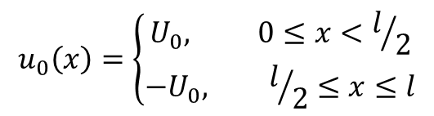
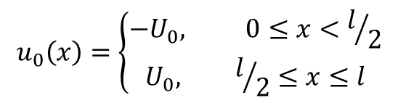
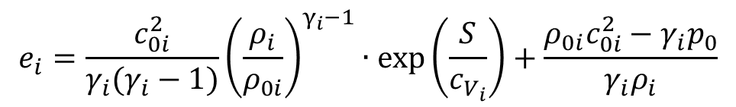
Numerical test problems (finite volume method is used)
Symmetric collision problem
Symmetric expansion problem
Notes:
Для демонстрации соответствия результатов расчёта характеристическим свойствам системы приводятся расчёты задач о соударении и разлёте для условных жидкостей.
Система для четырёхфазного течения имеет 4 положительных и 4 отрицательных характеристики. В случае столкновения, в обе стороны от точки контакта должны расходиться 4 ударных волны, в случае разлёта, -- 4 волы разрежения.
В качестве уравнения состояния для условных жидкостей берётся двучленное уравнение состояния.

Slide 52

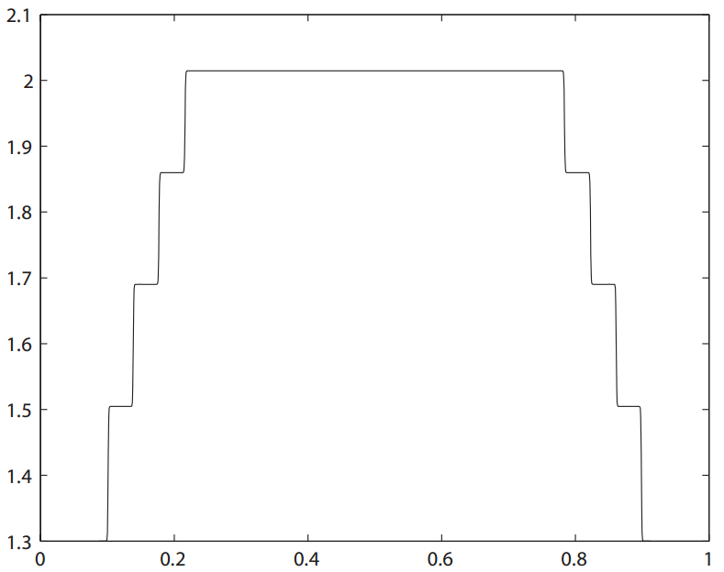
Symmetric collision
( 1000 м/s )
Mixture density
Material parameters of artificial liquids:
Notes:
На слайде представлен профиль плотности смеси в некоторый момент времени после соударения со скоростью 1000 м/с и параметры условных жидкостей. На графике отчётливо видны 4 ударные волны, расходящиеся в разные стороны от точки контакта.

Slide 53

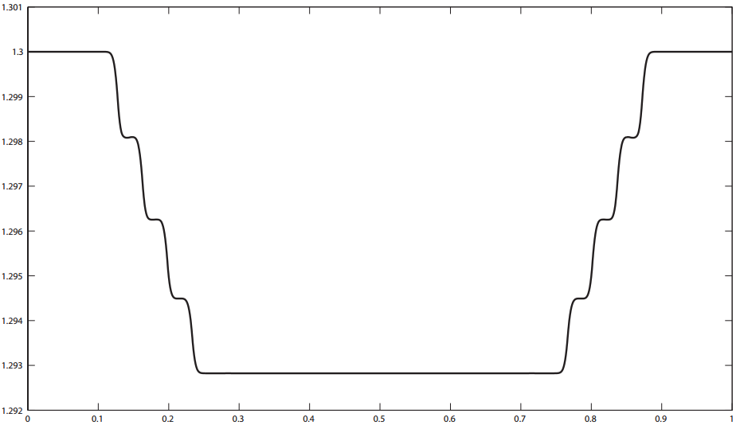
Symmetric expansion
( 100 м/s )
Mixture density
Notes:
А на аналогичном графике для случая разлёта – 4 волны разрежения.

Slide 54
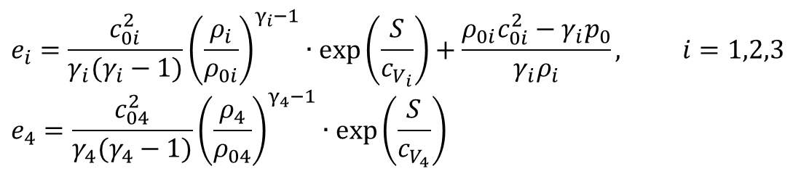
“Oil Reservoir” mixture test problem
Four phase mixture of silica sand, oil, water and methane is considered
Notes:
На слайде приведены параметры расчёта задачи для четырёхфазной «нефтяной смеси», состоящей из песка, воды, нефти и метана. В начальный момент времени в покоящейся смеси задаётся разрыв в давлениях.

Slide 55



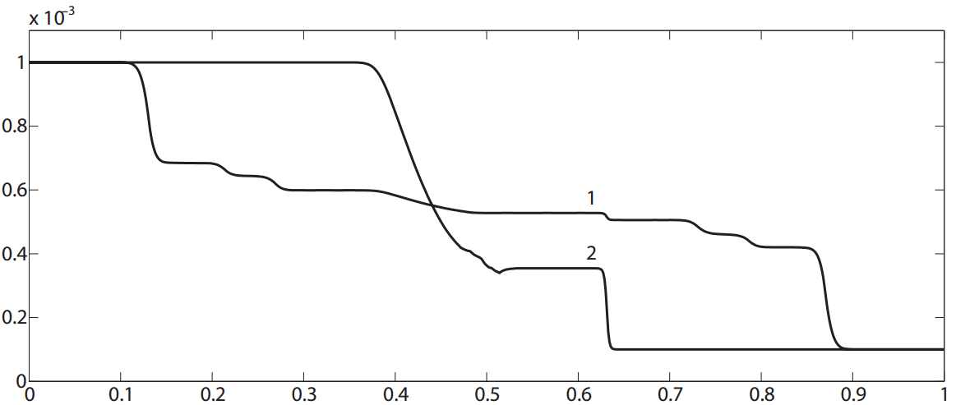
Riemann problem with initial data:
Pressure
1 – isentropic case, no pressure relaxation
2 – entropy is taken into account, instantaneous pressure relaxation
Notes:
На рисунке представлены профили давлений в изэнтропическом случае без учёта эффекта релаксации давлений и с пересчётом энтропии и мгновенной релаксацией давлений. В первом случае можно видеть 4 волны разрежения, распространяющиеся влево и 4 ударных волны, распространяющихся вправо. В случае же мгновенной релаксации давлений, волновая структура выглядит как состоящая из одной ударной волны и одной волны разрежения.

Slide 56
Resume
New approach for the design of multiphase compressible flow model based on the thermodynamically compatible system theory is proposed
The governing equation of the model are hyperbolic and all equations have a divergence form that allows one to apply known mathematical means and high accuracy numerical methods for study of the variety of problems

Slide 57
Термодинамически согласованные модели многофазных течений в пористых деформируемых средах
Моделирование многофазного течения смеси сжимаемых сред (жидкостей, газов) в пористых и трещиновато-пористых средах является актуальной областью исследований в приложении к исследованию режимов течения в нефтяных резервуарах. Для развития новых технологий интенсификации добычи нефти необходимо адекватное понимание процессов многофазного течения смеси насыщающих жидкостей и, в общем случае, конечной упругопластической деформации скелета формации.
Цель исследования заключается в создании новой модели динамики насыщенных смесью сжимаемых жидкостей упругопластеских пористых и трещиновато пористых сред в случае конечной деформации скелета. Модель должна быть физически и математически корректной.
57

Slide 58
Стратегия развития средств моделирования течения жидкостей в деформируемых пористых средах
Теория
термодинамически согласованных
гиперболических систем
законов сохранения
Высокоэффективные численные методы высокого порядка
Вычислительная основа для широкого класса геофизических приложений

Slide 59
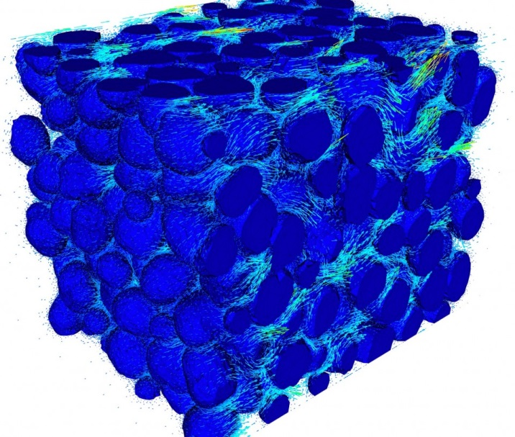
Насыщенная многофазной жидкостью пористая среда
Пористая
матрица
Насыщающие жидкости
Notes:
Здесь следует пояснить определение двухфазности, на базе которого строятся исследуемые в работе математические модели. Рассматриваются среды, представимые в виде двухскоростного континуума, состоящего из частиц двух фаз. Каждая фаза имеет свою скорость, парциальную плотность и вязкость. В рамках рассматриваемых моделей в среде не реализуются касательные напряжения. Двухфазная среда считается локально равновесной по температуре и относительное движение фаз вносит дополнительный вклад во внутреннюю энергию.
В результате применения метода законов сохранения, с учетом указанных свойств рассматриваемых двухфазных сред, приходим к следующим системам определяющих уравнений …

Slide 60
Параметры состояния насыщенной пористой среды
объемное содержание пористой матрицы (фаза 1)
объемные содержания насыщающих жидкостей (n=2,…,N)
физические плотности фаз
плотность многофазной среды
массовые содержания фаз
скорость фазы i (i=1,2,3)
скорости фаз относительно упругой матрицы
скорость многофазной среды
градиент деформаций (дисторсия) многофазной среды
плотность энтропии многофазной среды
пористость
60

Slide 61
Энергия насыщенной пористой среды
Внутренняя энергия многофазной среды
Полная энергия многофазной среды
Первый и второй начала термодинамики
61

Slide 62
Производящий потенциал
The partial derivations of the generating potential
62

Slide 63
Уравнения в терминах производящего потенциала
Закон сохранения энергии
63

Slide 64
Определяющие уравнения
бездиссипативная термодинамически согласованная модель
- закон сохранения массы
- балансное уравнение содержания фаз
- законы сохранения масс фаз
- уравнения для относительных скоростей
- закон сохранения импульса
- уравнение для градиента деформаций
64

Slide 65
Определяющие уравнения
термодинамически согласованная модель с диссипацией
- закон сохранения массы
- балансное уравнение содержания фаз
- законы сохранения масс фаз
- уравнения на относительные скорости
- закон сохранения импульса
- уравнение на градиент деформаций
65

Slide 66
Определяющие уравнения
термодинамически согласованная модель с диссипацией
Искусственная переменная
вводится для того, чтобы сохранить уравнение для относительных скоростей в дивергентной форме.
Параметр может рассматриваться в качестве источника, так как выполняется условие совместимости
66

Slide 67
Определяющие уравнения
производство энтропии и сохранение энергии
производство энтропии
закон сохранения энергии
Система термодинамически согласованных уравнений является гиперболической и все уравнения имеют дивергентную форму.
67

Slide 68
Распространение волн малой амплитуды в неподвижной среде
Упругая среда насыщенная одной жидкостью
- объемный модуль упругости упругих и жидких фаз
- модуль сдвига упругой среды
- коэффициент межфазного трения
68

Slide 69
Распространение одномерных волн
1-мерные гармонические волны
удовлетворяют дисперсионным уравнениям
продольные волны
волна сдвига

Slide 70
Распространение одномерных волн
1. Существуют две продольные звуковые волны - быстрая и медленная
(в соответствии с экспериментом)
2. Поперечная скорость распространения волны не зависит от
коэффициента межфазного трения, от пористости зависит
как
3. Если коэффициент межфазного трения стремится к бесконечности
(нет относительного движения), то существует только одна продольная
волна, ее скорость распространения
нелинейно зависит от пористости
70

Slide 71
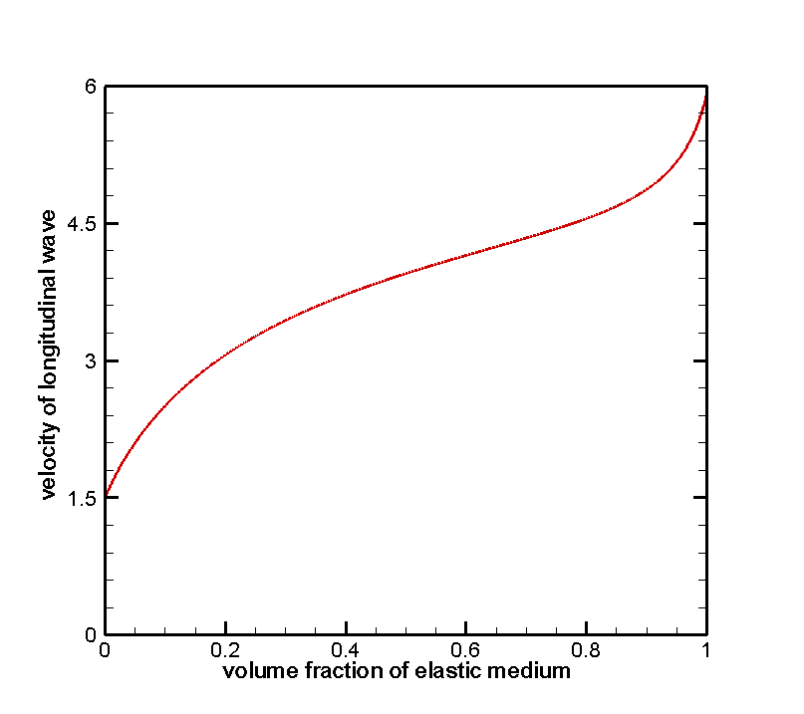
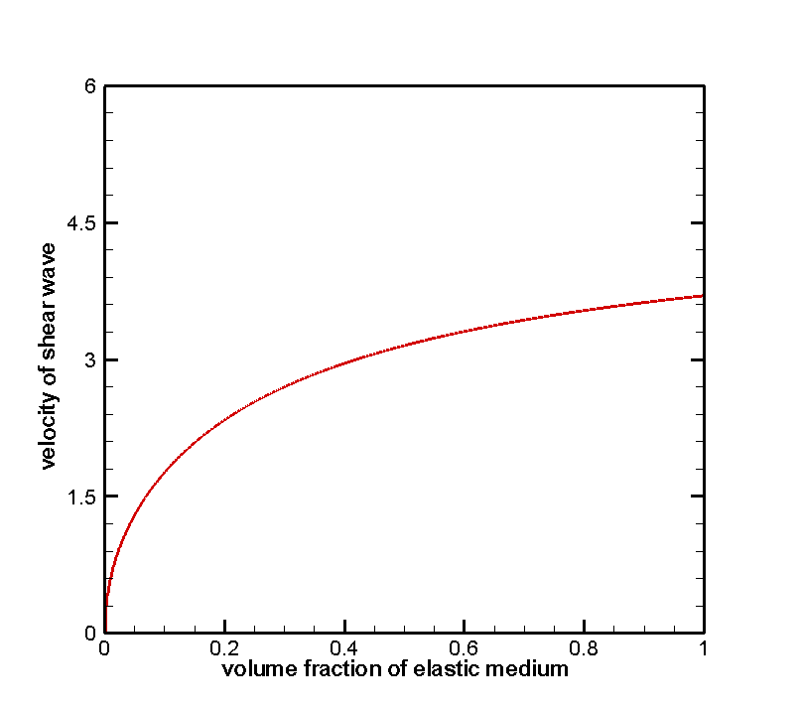
Скорости звука для бесконечного значения коэффициента межфазного трения
Пример: пористый песчаник, насыщенный водой
песчаник:
вода:
71

Slide 72
Распространение волн в пористой формации
насыщенная водонефтяной смесью пористая формация с пористостью 0.2
давление x-компонента девиатора напряжений
водонефтяной
контакт
водонефтяной
контакт
источник
источник
пористая среда
нефть вода
вода
пористая среда
нефть вода
вода
72

Slide 73
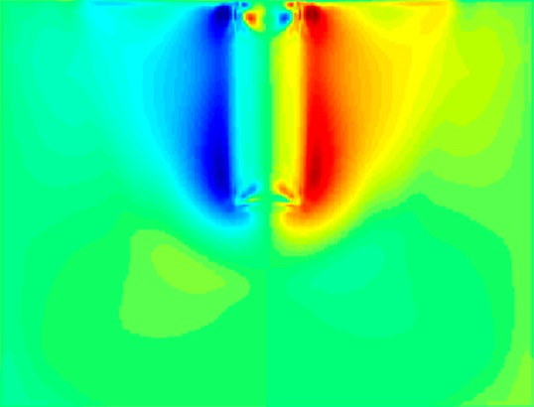
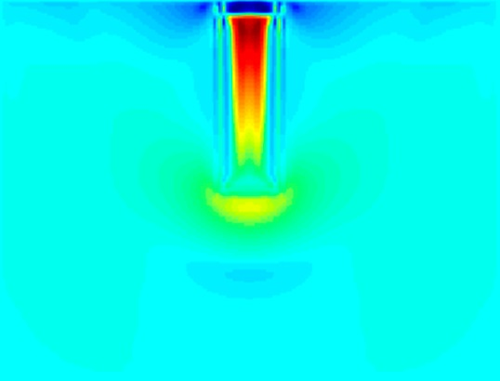
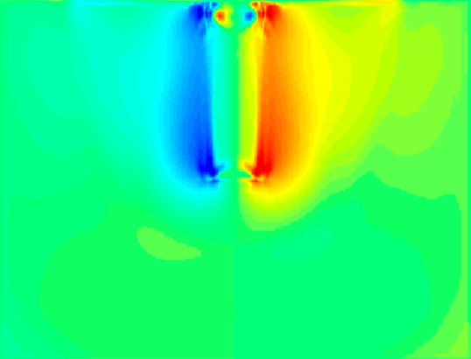
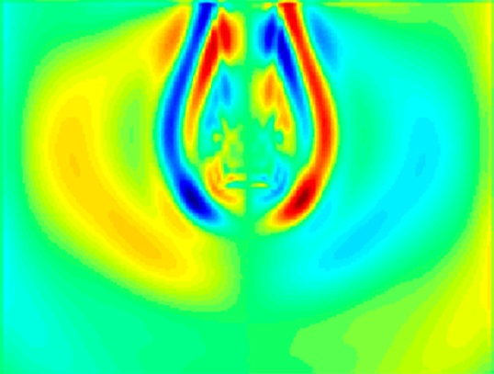
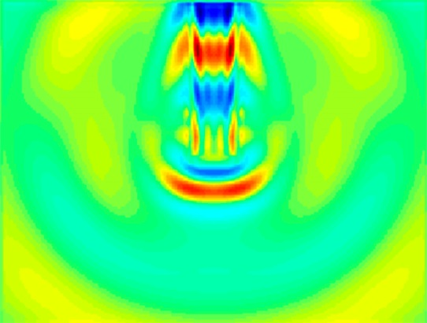
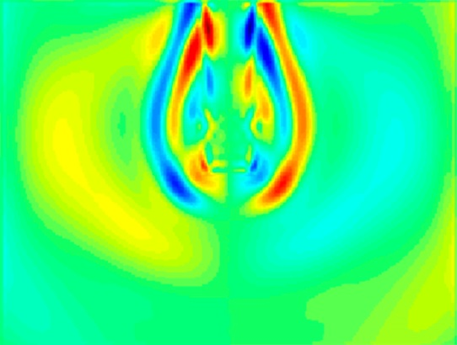
Фильтрация водонефтяной смеси
Фильтрация нефте-водяной смеси в заскважинное пространство при нагнетании смеси в скважину.
Поле скоростей воды (горизонтальная (слева) и вертикальная (справа) компоненты) и нефти (горизонтальная компонента). Акустический источник отсутствует.
Поле скоростей воды (горизонтальная (слева) и вертикальная (справа) компоненты) и нефти (горизонтальная компонента). Акустический источник (типа Рикера) находится в нижней части скважины.
73

Slide 74
Насыщенные пористые среды: выводы
Получена новая вычислительная модель течения многофазной сжимаемой смеси в насыщенных упругих пористых средах. Дифференциальные уравнения модели образуют гиперболическую систему и имеют дивергентную форму. Эти свойства позволяют применять численные методы высокой точности для решения широкого спектра прикладных задач.
Модель позволяет исследовать распространение сейсмоакустических волн, сопровождающихся диссипативными эффектами и температурными изменениями в формации и скважине, исследовать влияние акустических колебаний на течение жидкости (воды, нефти, их смеси, и т.д.) в деформируемых пористых средах, а также рассматривать конечные упругие деформации пористой матрицы такой среды.
74

Slide 75
Численный алгоритм
Определяющие соотношения образуют гиперболическую систему законов сохранения и могут быть представлены в форме:
Конечно-объёмная схема: $\frac{dU_{i}}{dt}+\frac{F_{i+1/2}−F_{i−1/2}}{Δx}=Q\left(x_{i},U_{i}\right)$
$F_{i±1/2}$можно получить путём решения задачи Римана с начальными данными $U_{L}$ слева и $U_{R}$ справа

Slide 76
Метод Рунге-Кутты-WENO
Интегрирование по времени методом Рунге-Кутты
Аппроксимацию $\frac{dU_{i}}{dt}+\frac{F_{i+1/2}−F_{i−1/2}}{Δx}=Q\left(x_{i},U_{i}\right)$ можно записать в форме $\frac{dU_{i}}{dt}=L\left(U_{i}\right)$
Для интегрирования по времени используется схема Рунге-Кутты 3-го порядка (Gottlieb 2005)
$где m=4, а α_{m,k} равны:{ α}_{4,0}=0, α_{4,1}=\frac{2}{3}, α_{4,2}=0, α_{4,3}=\frac{1}{3}$

Slide 77
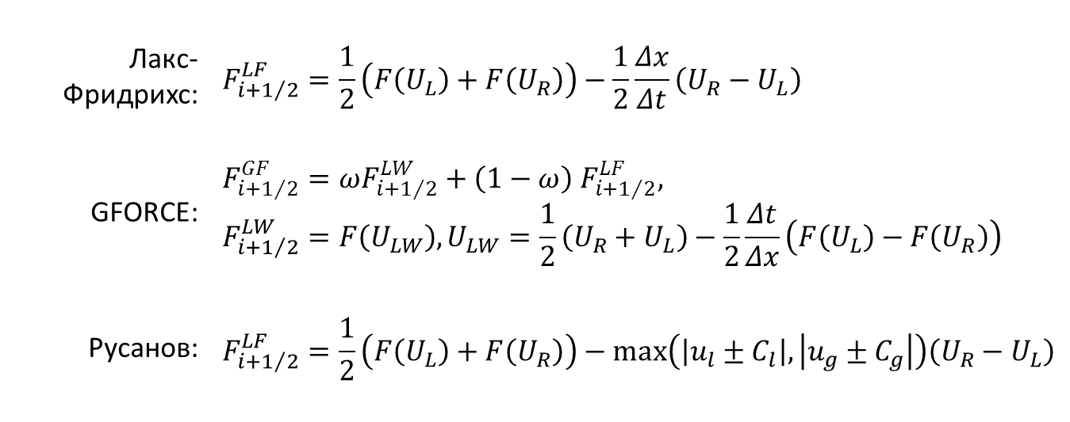
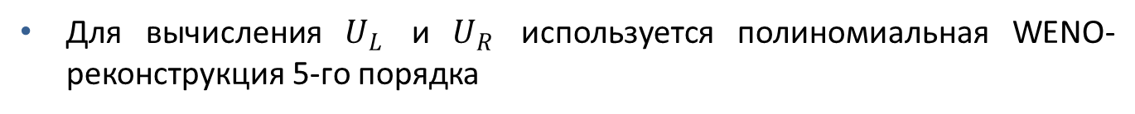
Метод Рунге-Кутты-WENO
Вычисление потоков
Для расчёта потоков через границы ячеек используется один из следующих методов:
Лакс-Фридрихс: | $$F_{i+1/2}^{LF}=\frac{1}{2}\left(F\left(U_{L}\right)+F\left(U_{R}\right)\right)−\frac{1}{2}\frac{Δx}{Δt}\left(U_{R}−U_{L}\right)$$
GFORCE: | $$F_{i+1/2}^{GF}=ωF_{i+1/2}^{LW}+\left(1−ω\right){ F}_{i+1/2}^{LF},$$ $$F_{i+1/2}^{LW}=F\left(U_{LW}\right), U_{LW}=\frac{1}{2}\left(U_{R}+U_{L}\right)−\frac{1}{2}\frac{Δt}{Δx}\left(F\left(U_{L}\right)−F\left(U_{R}\right)\right)$$
Русанов: | $$F_{i+1/2}^{LF}=\frac{1}{2}\left(F\left(U_{L}\right)+F\left(U_{R}\right)\right)−max\left(\left|u_{l}±C_{l}\right|,\left|u_{g}±C_{g}\right|\right)\left(U_{R}−U_{L}\right)$$
Для вычисления $U_{L}$ и $U_{R}$ используется полиномиальная WENO-реконструкция 5-го порядка

Slide 78
Метод Рунге-Кутты-WENO
WENO-реконструкция
Конечно-объёмный метод WENO (Weighted Essentially Non-Oscillatory) основан на локальной полиномиальной реконструкции значений параметров в ячейках для получения начальных данных для задачи Римана
t
x
Значения U_{L} и U_{R} используются для расчёта потоков через границы ячеек
Использование полиномов r-го порядка позволяет построить схему r-го порядка точности по пространству

Slide 79
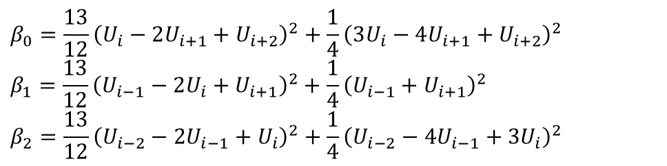
Метод Рунге-Кутты-WENO
WENO-реконструкция
Используется WENO-реконструкция 5-го порядка
Вычисление индикаторов гладкости
Вычисление нелинейных весовых коэффициентов
Индикаторы гладкости $β_{0,1,2}$ вычисляются для каждой ячейки:
$$β_{0}=\frac{13}{12}{\left(U_{i}−2U_{i+1}+U_{i+2}\right)}^{2}+\frac{1}{4}{\left(3U_{i}−4U_{i+1}+U_{i+2}\right)}^{2}$$
$$β_{1}=\frac{13}{12}{\left(U_{i−1}−2U_{i}+U_{i+1}\right)}^{2}+\frac{1}{4}{\left(U_{i−1}+U_{i+1}\right)}^{2}$$
$$β_{2}=\frac{13}{12}{\left(U_{i−2}−2U_{i−1}+U_{i}\right)}^{2}+\frac{1}{4}{\left(U_{i−2}−4U_{i−1}+{3U}_{i}\right)}^{2}$$
$$ω_{k}=\frac{α_{k}}{α_{0}+α_{1}+α_{2}}, где α_{k}=\frac{d_{k}}{{\left(ε+β_{k}\right)}^{2}}, k=0,1,2$$
$ε$ вводится для предотвращения деления на 0, обычно полагается ~ ${10}^{−6}$
константы $d_{k}$ различны для «правых» и «левых» значений $U_{R}$ и $U_{L}$

Slide 80

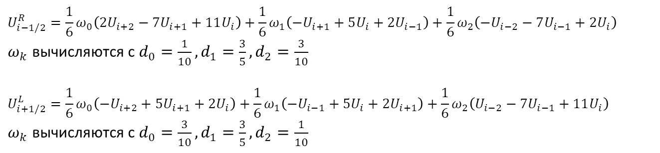
Метод Рунге-Кутты-WENO
WENO-реконструкция
Вычисление «правых» и «левых» величин
$$U_{i−1/2}^{R}=\frac{1}{6}ω_{0}\left(2U_{i+2}−7U_{i+1}+11U_{i}\right)+\frac{1}{6}ω_{1}\left(−U_{i+1}+5U_{i}+2U_{i−1}\right)+\frac{1}{6}ω_{2}\left(−U_{i−2}−7U_{i−1}+2U_{i}\right)$$
$ω_{k}$ вычисляются с $d_{0}=\frac{1}{10}, d_{1}=\frac{3}{5}, d_{2}=\frac{3}{10}$
$$U_{i+1/2}^{L}=\frac{1}{6}ω_{0}\left(−U_{i+2}+5U_{i+1}+2U_{i}\right)+\frac{1}{6}ω_{1}\left(−U_{i−1}+5U_{i}+2U_{i+1}\right)+\frac{1}{6}ω_{2}\left(U_{i−2}−7U_{i−1}+11U_{i}\right)$$
$ω_{k}$ вычисляются с $d_{0}=\frac{3}{10}, d_{1}=\frac{3}{5}, d_{2}=\frac{1}{10}$
В фиктивных граничных точках задаются большие значения:
$$U_{−i}={\left(10\left(i+1\right)\right)}^{10}, i=0,1,2$$
$$U_{N+i}={\left(10\left(i+1\right)\right)}^{10}, i=1,2,3$$

