Slide 1
Towards to Air Pollution Detection With Internet Of Vehicles
Vladimir Shakhov, Olga Sokolova
ICMMG

Slide 2
Internet of Vehicles
Internet of Vehicles is a large-scale distributed system for wireless communication and information exchange between vehicle, road, human and internet, according to agreed communication protocols and data interaction standards.

Slide 3
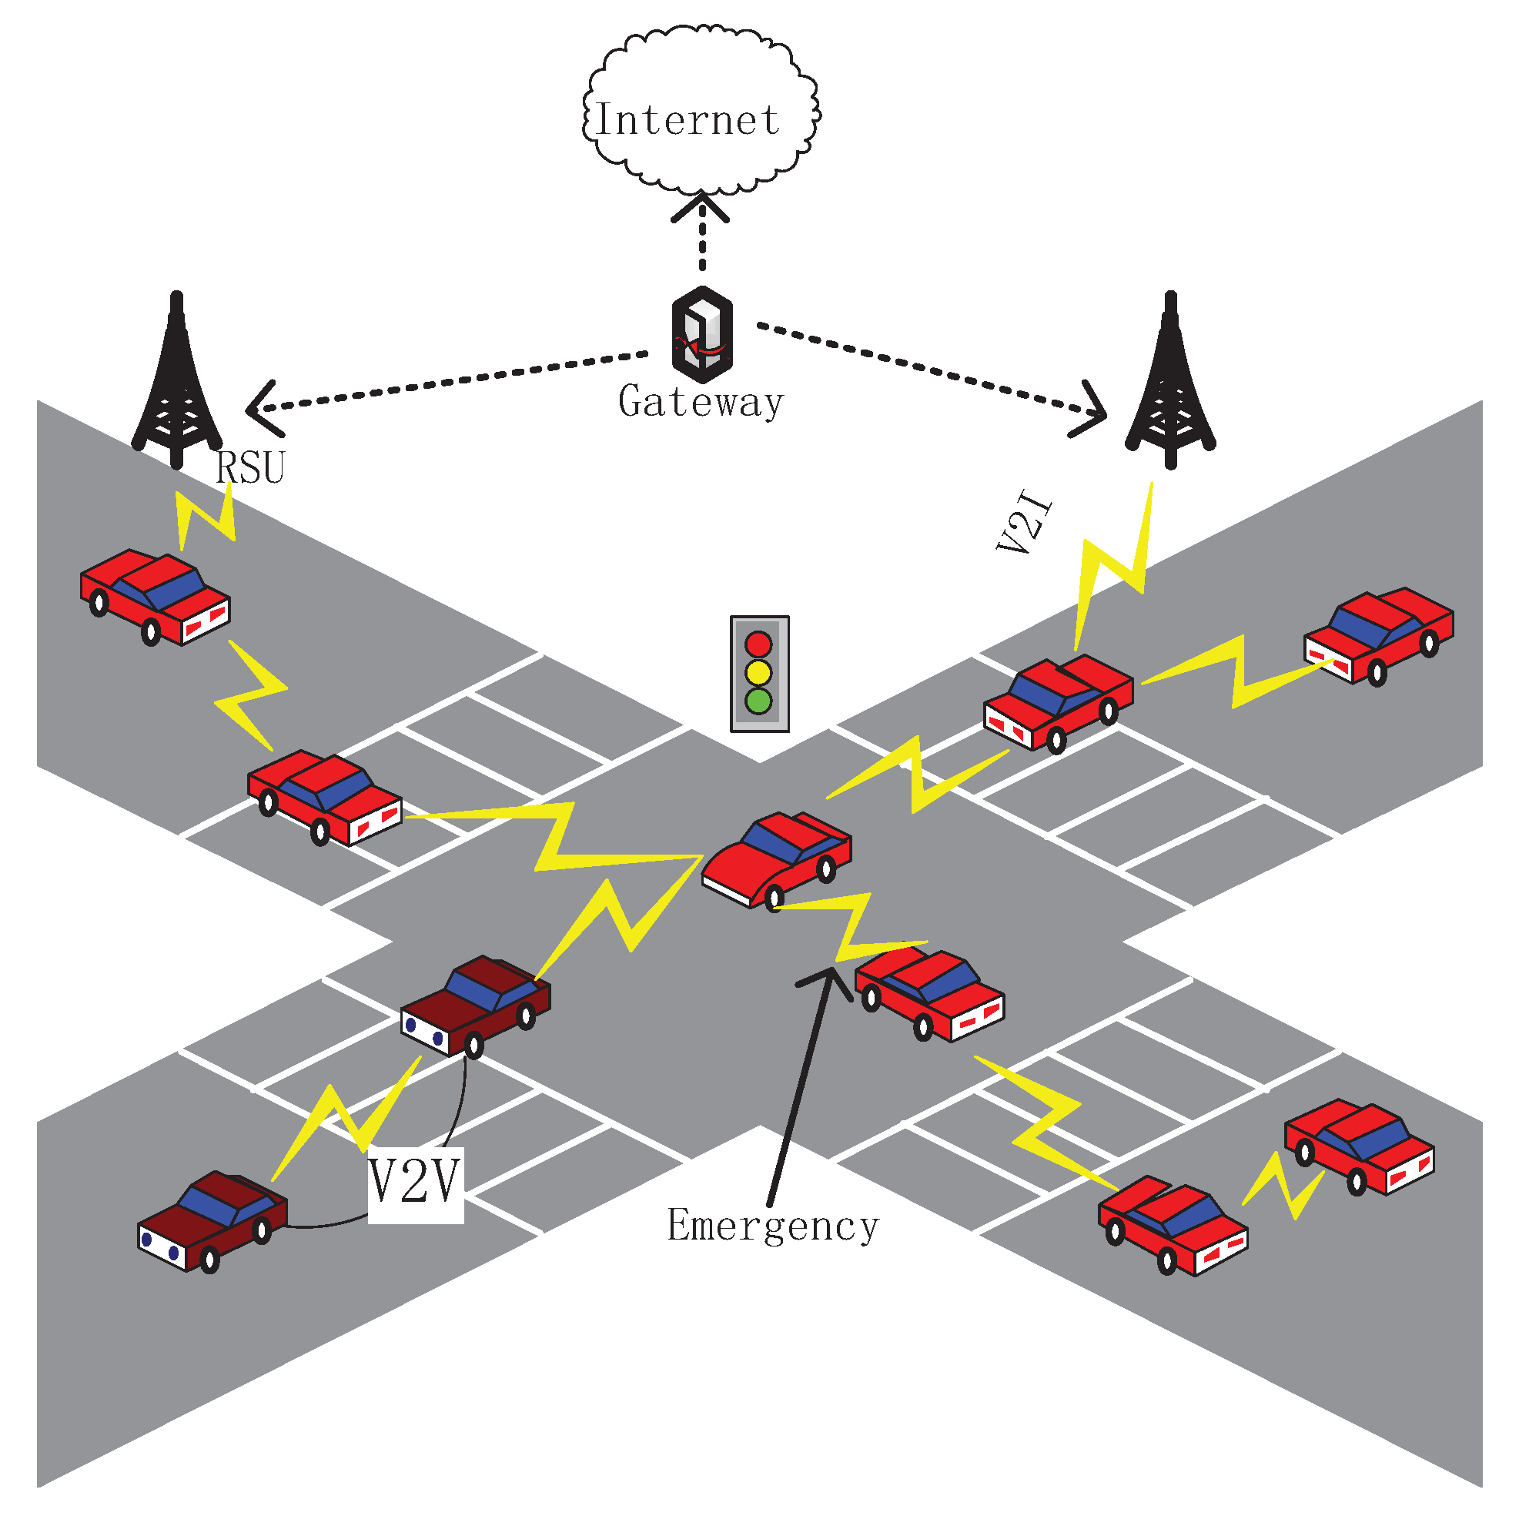
VANET
Vehicular Ad Hoc Networks
Vehicular ad -hoc networks are responsible for the communication between moving vehicles in a certain environment. A vehicle can communicate with another vehicle directly which is called Vehicle to Vehicle (V2V) communication, or a vehicle can communicate to an infrastructure such as a Road Side Unit (RSU), known as Vehicle -to-Infrastructure (V2I).

Slide 4
Monitoring using WSN
Wireless sensor networks consist of nodes equipped with sensors that receive information from the environment and relay it to base stations (stocks). The advantages of WSN include the energy autonomy of the nodes, the possibility of flexible changes in the network topology, improved spatio-temporal detail of measurements, and lower operating costs. A similar system was deployed and tested in some European cities, for example, Cambridge.
Monitoring using a sensor network can be improved, for example, through the use of mobile nodes. This approach was also used to organize monitoring of the atmosphere. The concept of sensor networks with sensors on automobiles (vehicular sensor networks) was studied in [7], the authors using simulation modeling analyze the effectiveness of the technologies used and data aggregation methods. In Uppsala (Sweden), wireless networks were used to monitor air pollution, where public transport was used as a mobile sensor carrier

Slide 5
Urgent problem of air pollution monitoring in megacities
Wireless sensor networks are used to increase the effectiveness of the atmosphere monitoring.
Network nodes equipped with sensors receive information from the environment and transmit it to base stations for further processing.
Two variants of the road traffic are considered: deterministic and Poisson flow (in the last case the vehicles inter-arrival time in the area of interest is exponentially distributed random variable).
The presence of an elevated level of pollution is determined during the stay of the vehicle in the study area with a certain probability.
The cumulative distribution function for the rate of critical air pollution detection is offered. The results can be used to control the operation of air monitoring systems using vehicles equipped by sensors.

Slide 6
System Model
A sensor located on a vehicle detects an event to be monitored (emission of toxic gases, exceeding the pollution threshold, etc.) with a certain probability p.
The indicated value depends on the sensitivity of the sensor, the time spent by the vehicle in the area where the sensor installed on it is able to detect pollution, as well as the concentration of polluting gases.
Approaches to estimate the value of p:
  Pollution concentration model
  Probabilistic model (exponential decay)
  Pure experiment

Slide 7
Two types of vehicles flow into the pollution zone Z
First case: the time interval of the vehicle movement is constant, which is typical, for example, for trams of the same route or suburban trains.
Second case: several types of urban transport are used for monitoring on a variety of routes, the time between the arrivals of the vehicle in a certain segment of the road (area Z) will be random. This flow is usually considered Poisson, i.e. time between vehicles is distributed exponentially. A study was conducted in Beijing that experimentally confirmed this assumption.

Slide 8
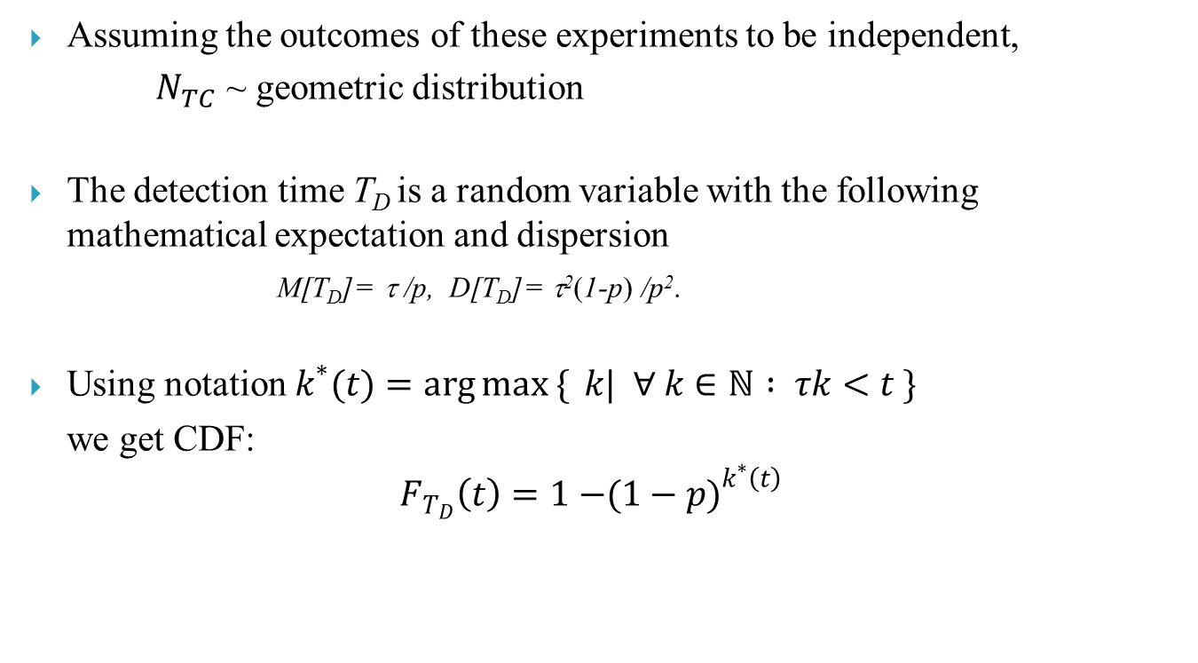
Deterministic traffic
Assuming the outcomes of these experiments to be independent,
$N_{TC}$ ~ geometric distribution
The detection time T_{D} is a random variable with the following mathematical expectation and dispersion
  M[T_{D}]= τ /p, D[T_{D}]= τ²(1-p) /p².
Using notation $k^{∗}(t)=\arg{\max{\{} k| ∀ k∈ℕ : τk<t }\}$
we get CDF:
$$F_{T_{D}}\left(t\right)=1{−(1−p)}^{k^{∗}\left(t\right)}$$

Slide 9
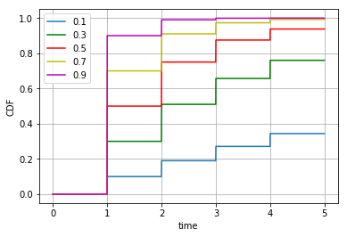
TD distribution function for t=1 some p values from 0.1 to 0.9
We have obtained a piecewise constant non-decreasing function; its graphic for =1 and some values of p

Slide 10
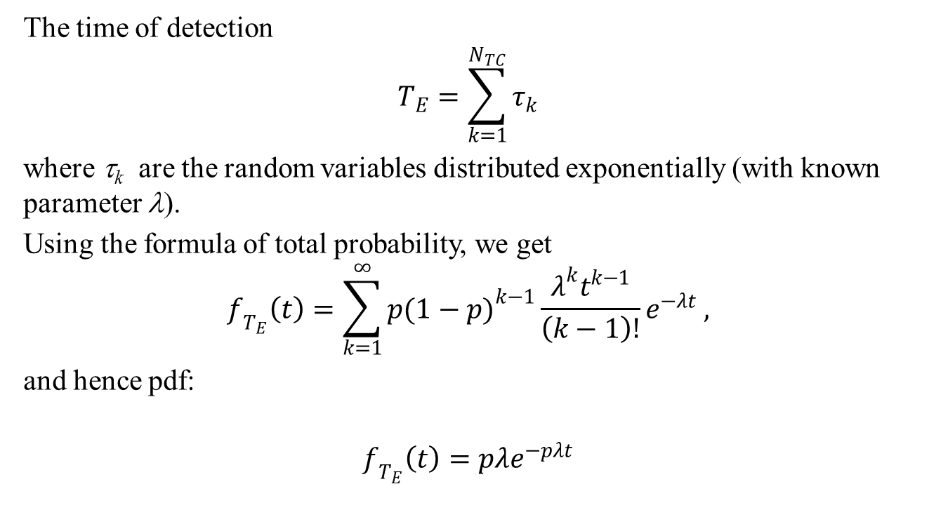
The case of Poisson flow
The time of detection
$$T_{E}=\sum_{k=1}^{N_{TC}}{τ_{k}}$$
where τ_{k} are the random variables distributed exponentially (with known parameter λ).
Using the formula of total probability, we get
$$f_{T_{E}}\left(t\right)=\sum_{k=1}^{∞}{{p(1−p)}^{k−1}}\frac{λ^{k}t^{k−1}}{\left(k−1\right)!}e^{−λt} ,$$
and hence pdf:
$$f_{T_{E}}\left(t\right)=pλe^{−pλt}$$

Slide 11

Problem: Optimal Number of Vehicles
A pollution has to be detected in h time units with a probability α.
What is the minimum number of vehicles required?
$$N_{A}→min$$
$$P\left(T_{E}<h\right)≥α$$

Slide 12
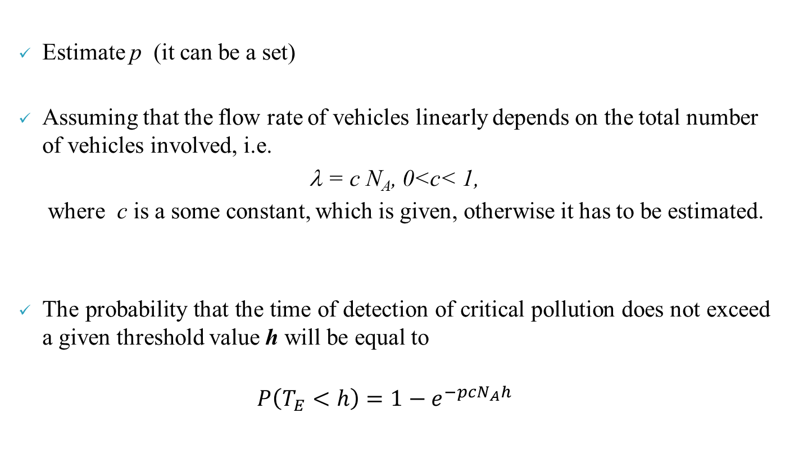
Approach
Estimate p (it can be a set)
Assuming that the flow rate of vehicles linearly depends on the total number of vehicles involved, i.e.
λ= c N_{A}, 0<с< 1,
where c is a some constant, which is given, otherwise it has to be estimated.
The probability that the time of detection of critical pollution does not exceed a given threshold value hwill be equal to
$$P\left(T_{E}<h\right)=1−e^{−pcN_{A}h}$$

Slide 13

Problem: Optimal Number of Vehicles
$P\left(T_{E}<h\right)$ is a monotonically increasing function of $N_{A}^{}$
Thus,
$N_{A}^{}=\arg{ \left\{P\left(T_{E}<h\right)=α\right\} }$
The choice of sensor type can be optimized as well.

Slide 14
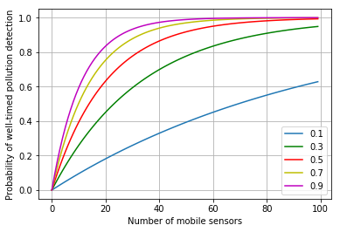
The probability of detecting critical air pollution within a specified time.
α = 0.9
Figure shows the probabilities of detecting a critical level of air pollution over a period of time not exceeding a predetermined threshold value depending on the number of vehicles involved. In this example, c = 0.1, h = 1, p takes values from the set {0.1;0.2;0.5;0.8;0.9}.

Slide 15
Results
The results obtained allow us to solve various inverse problems. For example, the following problem is of great relevance: for a given probability of detecting critical air pollution, it is necessary to calculate the minimum detection time or the required number of vehicles with sensors installed on them.
The described studies also allow developing methods for optimizing the cost of atmospheric monitoring systems.

Slide 16
Спасибо за внимание

