Slide 1
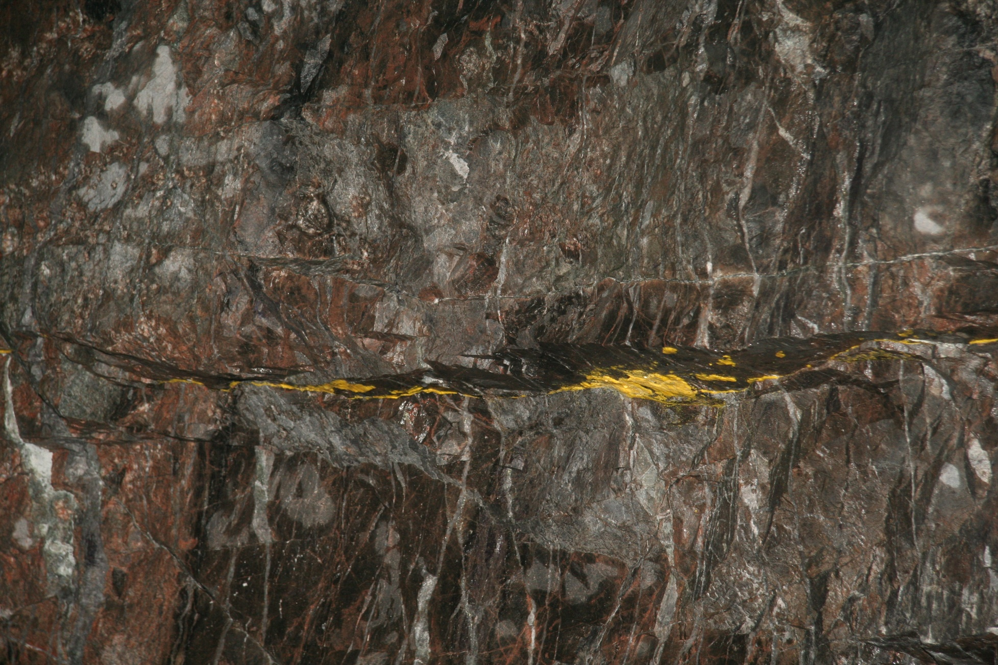
A P3D model for fracture growth across multiple elastic layers
Xi Zhang^{A,B}
^{A}CSIRO Energy, Melbourne, VIC 3168, Australia. ^{B}On leave at Institute Of Rock and Soil Mechanics, CAS, Wuhan, China
Onshore gas Program
Notes:
Only twenty minutes. 4 minutes for discussion

Slide 2
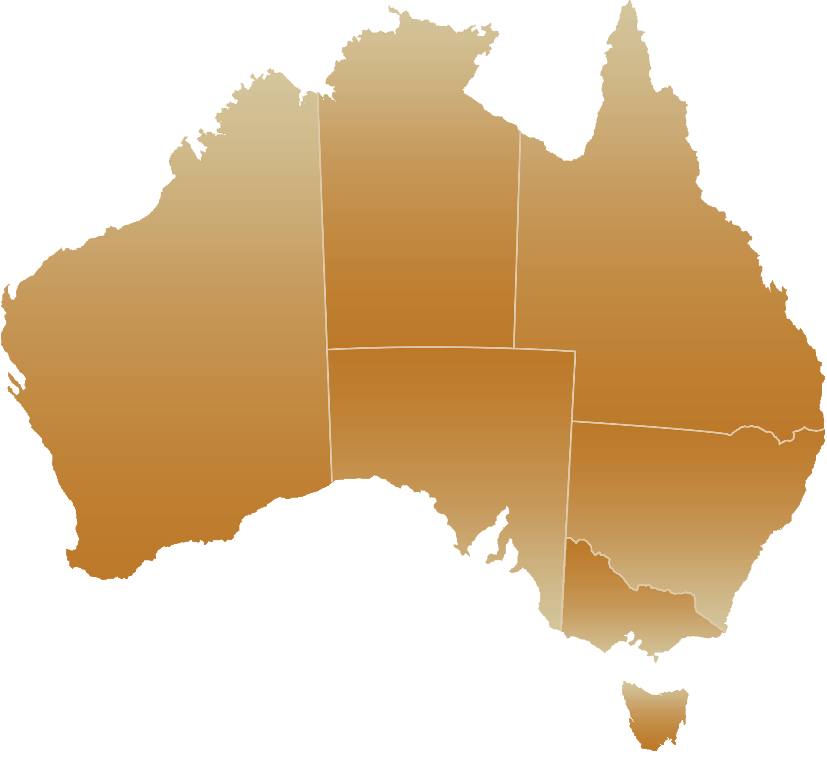
CSIRO
Australia’s National Science Agency
Darwin
Established
1926
Cairns
Atherton
Townsville
2 sites
Alice Springs
People
4500
Rockhampton
Murchison
Bribie
Island
Locations
55
Toowoomba
Brisbane
6 sites
Geraldton
2 sites
Gatton
Myall Vale
Armidale
2 sites
Narrabri
Perth
3 sites
Mopra
Newcastle
Adelaide
2 sites
Parkes
Budget
∼$1B
Irymple
Griffith
Sydney 5 sites
Wodonga
Canberra 7 sites
Belmont
Werribee 2 sites
Melbourne 5 sites
Top 1% of global research institutions in 14 of 22 research fields
Top 0.1% in 4 research fields
Geelong
62% of our people hold university degrees
2000 doctorates
500 masters
Hobart
Sandy Bay
Supervising 650 postgraduate students with university partners

Slide 3
Outline
Introduction
Model
Numerical Results
Conclusions

Slide 4
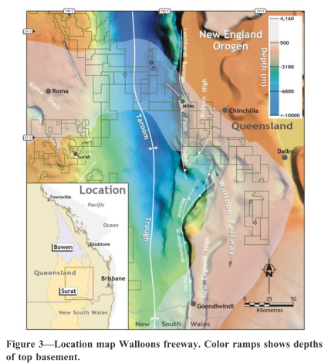
Walloons Coal at Surat Basin
Locations of Walloons Coal Seam Gas Reservoirs
Many untargeted seams are fractured due to vertical growth. (Pandey and Flottmann, SPE, 2015)
Pandey and Flottman, 2015

Slide 5
Multilayer Structure and Hydraulic Fracturing
Layered coal seam structures at Surat Basin (Pandey and Flottmann, 2015)
  Thin Walloon coal seams range from 0.2 to 3 m in thickness.
  Inter-burden (non-coal) rock layers are impermeable.
  Large modulus contrasts between coal seams and non-coal rocks.
Hydraulic fracturing technique is used to enhance the permeability of coal seams. For most cases, vertical wells are used.
Coals are fractured. If Slick water is used, the fracture area is spreading, while cross-linked gel is used, fracture is more like a planar fracture. The latter is our concern for the model.
Layer fracture model| Xi Zhang

Slide 6
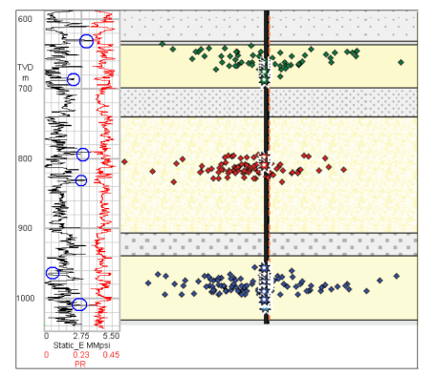
Modulus Contrast
If a hydraulic fracture is confined in a layer, low viscosity fluid and low injection rate are used (Kirk-Bounnand et al, 2015). However, this is not suitable to fine-thickness low-permeability coal seams. How to optimize fracture design.
What is the consequence of stress and material property contrasts?
Micro-Seismic events show the fractures are confined by sharp changes of modulus.
Crack deflection to form L or T shaped fractures (Jeffrey et al., 2015, CSIRO

Slide 7
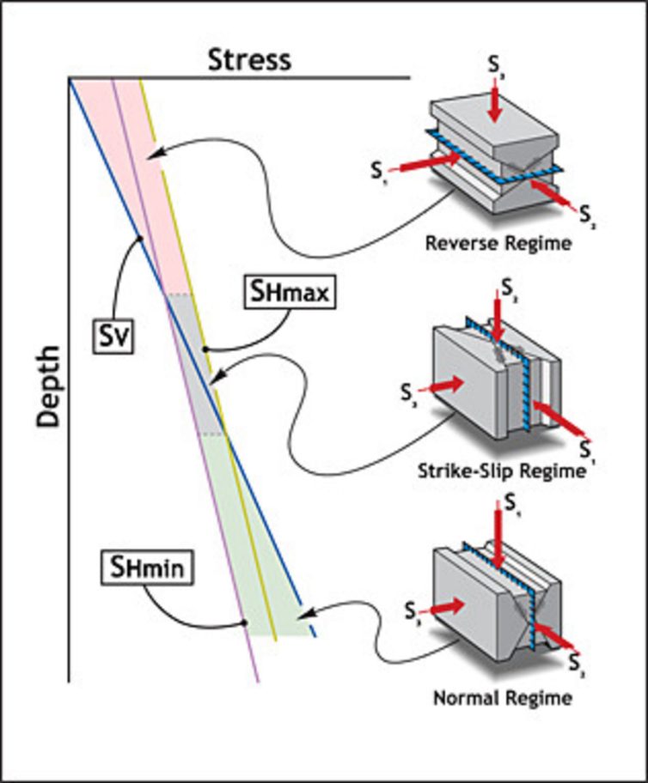
Fracture Types and Stress Conditions
Special stress conditions for the coal seams that located in
between 400 and 900 m.
Transition between Reverse and Strike-slip regime.
Upward growth could be arrested by Reverse regime or weak interfaces to form horizontal fractures.
Fracture plane could mainly be vertical for deeper fractures. This is considered by this talk.
Stress along depth from Pandey and Flottmann, 2015

Slide 8
Previous Work and Findings
Modulus contrast can provide a barrier to vertical growth. (Zhang et al. 2007; Gu et al, 2011; …)
Horizontal growth can be generated by weak interfaces and inside a layer. (Gu, et al., 2000, 2008; Gu and Weng, 2011; Jeffrey et al., CSIRO Internal report, 2015)
Discontinuities (Chuprakov et al, 2014; ..)
Complex fluid flow (Weng 1992)
Proppant transports (Dontsov and Peirce, 2014, 2015)
Production and induced stress changes

Slide 9
Outline
Introduction
Model
Numerical Results
Conclusions

Slide 10
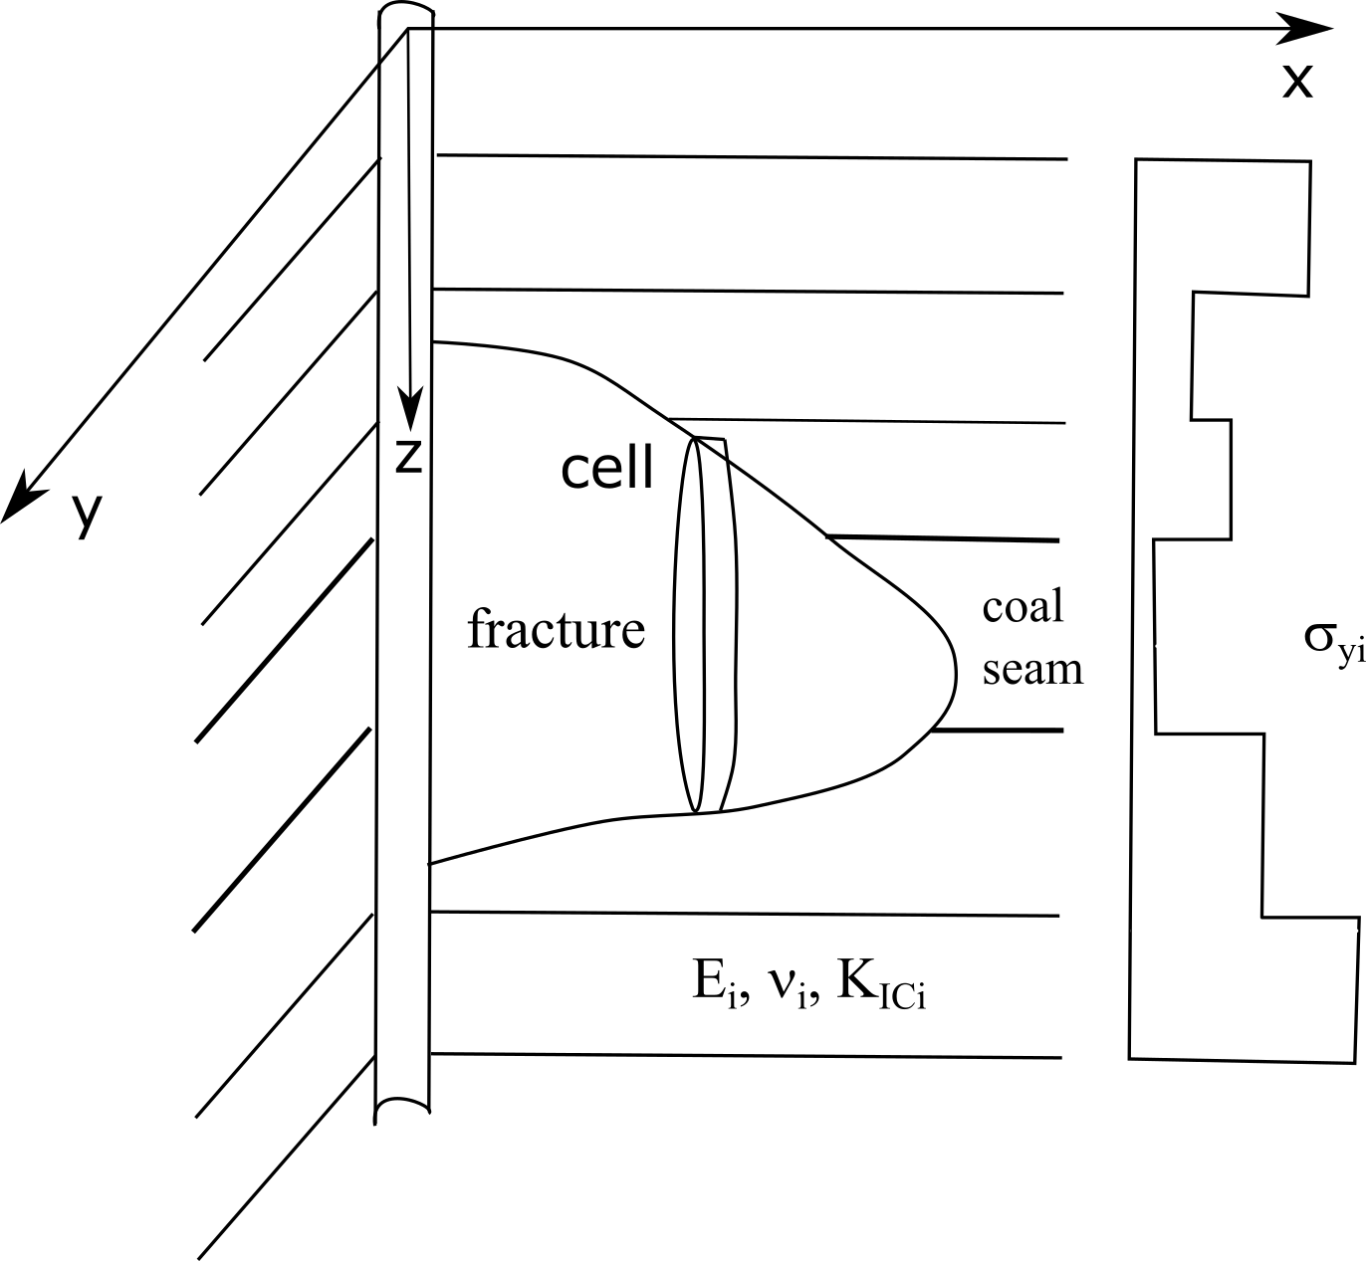
Multi-Layer P3D Model
Aims: to consider fracture growth into a multiple layer rock and to provide fracture shape and opening.
Cell-based Pseudo-3D fracture model: No Fluid lag +Open mode fractures
Elastic properties and stress contrasts between layers are considered.
Fracture surface contact is considered.
From Zhang et al., IJSS, 2017

Slide 11
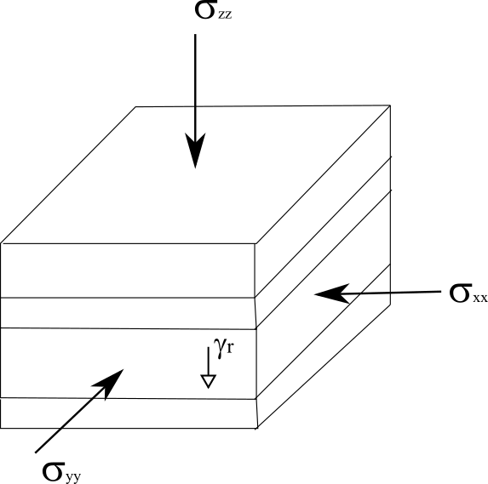
Layer Stresses due to Modulus Contrasts
(Bourne, 2003)
Stress-strain relations in each layer
The lateral strains across layers are the same.
The resultant stress along the depth should be equal
to the tectonic stress
The governing equations (right) and solve for the strains.
Finally calculate the stresses for each layer.
Tectonic stresses and Overburden stress
Two tectonic stresses
OB stress at the top
Gravity force

Slide 12
Assumptions
The elastic deformation in a cell is plain strain.
The pressure distribution in each cell is uniform
The fluid flow direction is horizontal only. The horizontal flow is described by a mass balance equation.
Layer interfaces are strongly bonded (No interface Fractures).
Fracture propagation occurs in both horizontal and vertical directions by satisfying the LEFM failure criterion.

Slide 13
Governing Equations
Plane-strain elasticity (only opening is involved)
Fluid flux in horizontal direction (Cubic law)
Mass balance for horizontal flow
(Adachi et al., 2007)

Slide 14
Validation of Green’s Functions
We calculate Green’s function for multi-layers based on image methods. How to truncate the image series? We use up to five-order images or a section of five layers.
Three-layer problems
E2
E2
2a
E1
2a
E1
2d
d/a=0.1
a/d=0.8

Slide 15
Moving Fronts
Calculate Stress Intensity factors based on displacements
Crack front movement in both vertical and horizontal directions
When one criterion is met, a new element is added in the corresponding direction for a specific cell.
Vertical Fracture toughness
Horizontal Fracture toughness
Additional terms are attributed to viscous fluid flows.
e is 0.15 times of cell height.
d is the cell width.
χ highlights cell interaction and needs calibration.
Notes:
Chi for

Slide 16


Solution Method
We need iteration method to solve elastic deformation in each cell. Normally, use cell-based pressures. Here we use a fluid volume-based optimization method. (Zhang et al., IJSS, 2017)
For given fluid volume of a cell, find the solution.
More stable compared to fluid pressure
Contact problem solved by iterations
Although no theoretical solutions are used, we can solve it cell by cell. So Parallel computing is used.
functional

Slide 17
Model Verification
Comparison with fully-3D code outcomes and PKN solutions
K_{IC}=0
K_{IC}=1.5 MPa m^{0.5}
* ILSA is a planar-3D code for homogeneous solids with stress contrast.
By varying the only-undetermined parameter χ in the model to generate close heights to ILSA. Its ranges for six cases are obtained.
From Zhang et al., JPSE, 2018

Slide 18
Determine χ
0.42
χ
0.31
0.28
0.2
Κ
Can we apply this relation to more general cases???

Slide 19
Computation Speed and Mesh Sensitivity
Computing time for Fig. 9(a) in the study by Dontsov and Peirce (2015)
Use the left Eq to calculate χ.
The results show less mesh sensitivity.
on a CSIRO Dell PowerEdge M630 cluster
From Zhang et al., JPSE, 2018

Slide 20
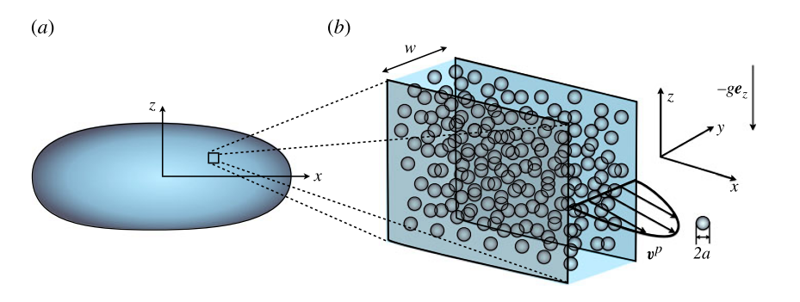
Proppant Transport
Proppant transport
where
From Dontsov and Peirce, 2014
Fluid mass balance
unknown

Slide 21
A solution method for proppant transport
Integrate proppant transport equation along the z-direction
The total particle volume in each cell is obtained by solving the equation. To avoid concentration oscillation, WENO method is used.
Block function is exactly the same as Wang et al. (2018).
=0 at fracture edges.
No discontinuity.
In which
Qx
Qz

Slide 22
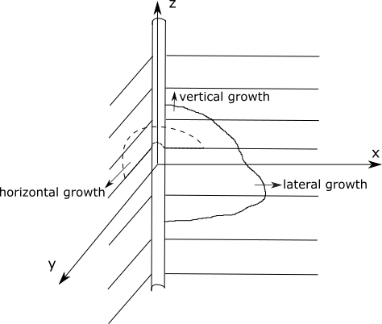
Proppant settling
Assume that particle setting rapidly reaches the steady state in a cell.
Based on the constraint: the total particle in this cell
is known
If some elements have a large concentration, they are assigned to the critical concentration. numerically, rearrangement restarts.

Slide 23
Outline
Introduction
Model
Numerical Results
Conclusions

Slide 24
Example 1: Injection Pressure Variations

Slide 25
Input Data
Depth=700m at Z=0, vertical fracture growth
Rock
Coal
Fluid
Two closely-spaced seams
Two stress conditions
Perforation layer
Mesh used

Slide 26
Fracture Shape and Opening Contours
Fracture propagates upwards to untargeted seams
The fracture front in the perforation layer stops growth.
Larger opening exists in softer coal seams.
42.3 s
99.4 s
162.9 s

Slide 27
Varying Injection Pressure
Actual measurement of injection pressure variations
Two different options for calculating χ produce similar results.
Use layer-based results below.

Slide 28
Alternating Vertical and Horizontal Growth
There are two periods when height growth is temporarily arrested. This is caused by softer layers.
The faster height growth rate causes a faster drop in injection pressure.
42.3 s
99.4 s

Slide 29
Cross-Section Opening near Well
Confining stress is 6.8 MPa
for all layers
With stress contrast
Height is the same at this time instant (t=142 s).
Although opening values depend on stress contrast, the opening shapes are the same for two cases.

Slide 30
Example 2: in situ Stress Variations

Slide 31
Input Data
Mesh for a two-coal seam rock body.
Each cross point is an element.
Cell number increases with fracture growth.
The height locations for the coal seam tops and bottoms are (49.3, 49.8) and (68.5, 69.3).
The coal seams have Young’s modulus of 4 GPa, Poisson’s ratio of 0.4, density of 2,000 kg/m³ and fracture toughness of 0.67 MPa.m^{0.5}.
The stiffer rocks have Young’s modulus of 20 GPa, Poisson’s ratio of 0.2, density of 3,000 kg/m³ and fracture toughness of 0.67 MPa.m^{0.5}.
The fracturing fluid is taken as slick water with a viscosity of 0.001 Pa.s and the fluid density of 1,000 kg/m³. The injection rate used in the simulation is 0.04 m³/s.
A weak plane at z=47 stops further upward growth.
Injection point

Slide 32
Stress Conditions
Use the above equation to calculate stresses based on tectonic stresses.
Two tectonic stresses
14 and 21 MPa
* Stresses within each layer.
σz0= 15, 15, 17 MPa

Slide 33
Simulation Result – Injection Pressure
The varying trends of injection pressure are the same even in situ stress calculation method is changed.
Pressure tends to reduce at large time. No dominated horizontal fracture growth occurs.
PKN and T-shaped dominant growth modes have different injection pressure responses.

Slide 34
Overburden Stress changes
* Overburden stress =15, 17 MPa
Fracture lengths in coal seams are shorter.
Upward growth is constrained by the upper coal seam.
Max opening is not in coal seam, but in the rock mass close to interface.

Slide 35
Example 3: Proppant transport

Slide 36
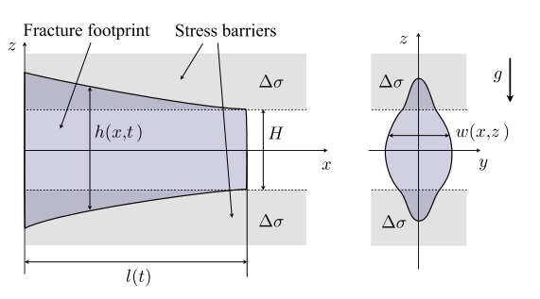
Input data
Stress conditions:
Pay zone stress (σ1)
Upper and lower rocks (σ2)
Sand inj rate: 0.5 kg/s Vol% =5%
10 m
Water density 1000 kg/m^3
Sand density 1500 kg/m^3
a homogeneous rock with a Young’s modulus E=1 GPa and a Poisson’s ratio ν=0.2. Toughness is zero.
Inj rate and prop rate
Δρ=500kg/m^3
The fluid viscosity is 0.1 Pa∙s and the total injection rate Q₀=0.01 m³/s.
Time (s)
250
300
650

Slide 37
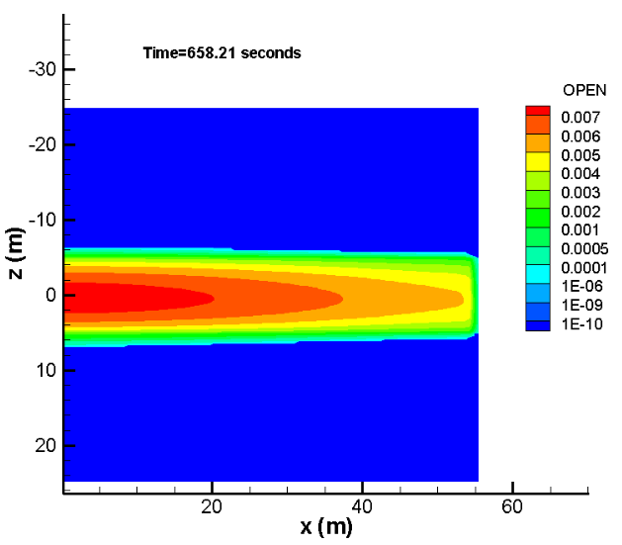
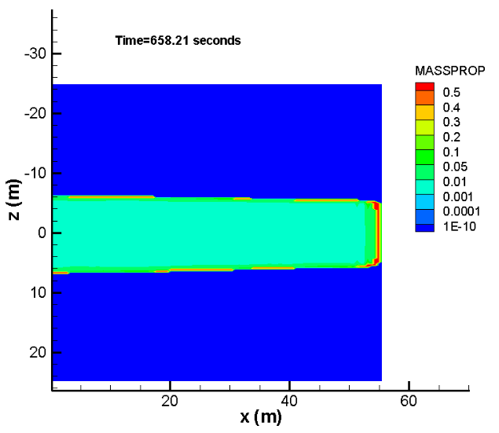
CASE I: Stress difference is 7.2 to 8.0
Particle size =10 microns (ceramic and flour)

Slide 38
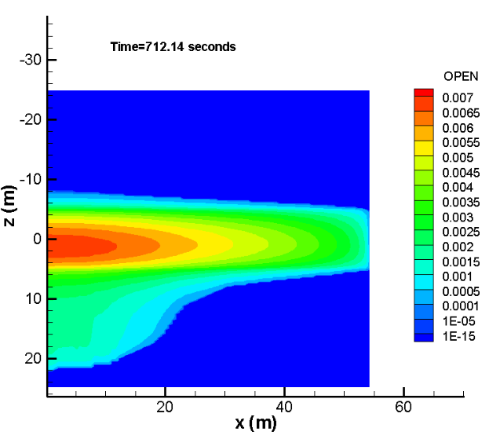
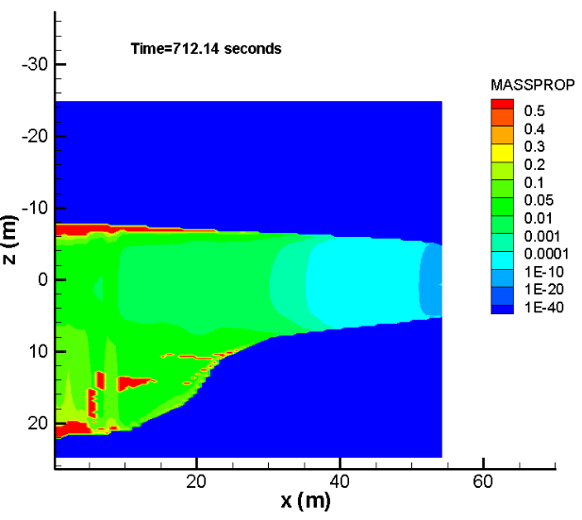
CASE II: Very fine particles
Particle size =10 microns
And stresses are 7.2 and 7.6 MPa

Slide 39
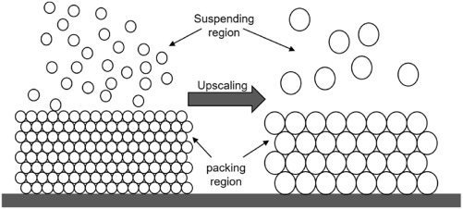
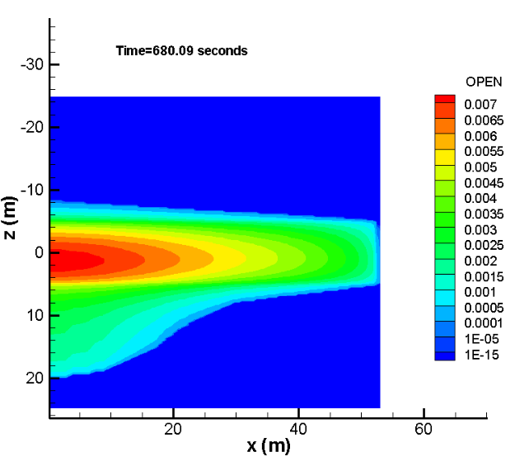
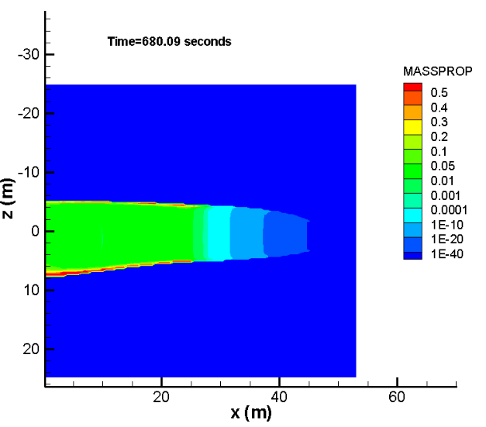
CASE III: Particle size is increased
Stresses are 7.2 and 7.6 MPa
Particle size =500 microns (sand)

Slide 40
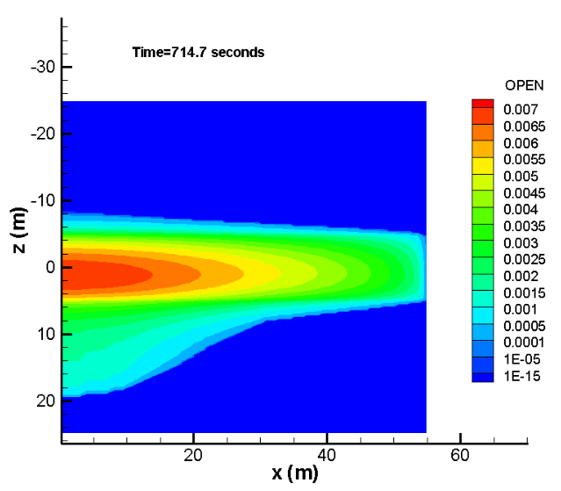
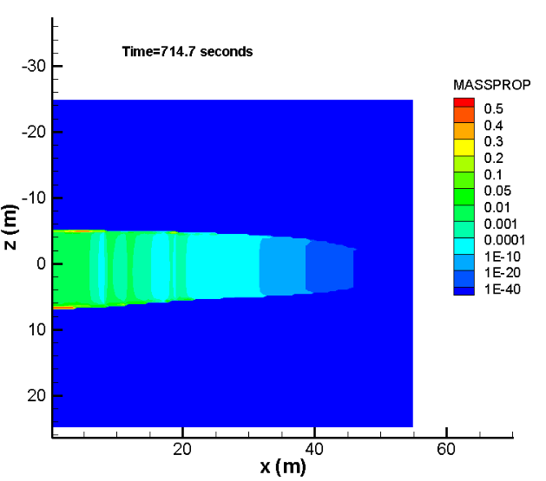
CASE IV: Proppant injection rate is reduced
Stresses are 7.2 and 7.6 MPa
Particle size =500 microns
Proppant inj rate= 0.05kg/s
Longer fracture

Slide 41
Outline
Introduction
Model
Numerical Results
Conclusions

Slide 42
Conclusions
An attempt was made on MLP3D from fracture generation, proppant transport to production for coal seam gas stimulation in multiple thin layers.
Modulus contrasts and stress variations are two important factors. The untargeted seams can be fractured by vertical growth.
Oscillating injection pressure change implies that the horizontal fractures are not dominated.
How is vertical growth limited? Larger stress in coal seams due to strain compatibility can make vertical growth difficult. Proppant gravity effect can do too.

Slide 43
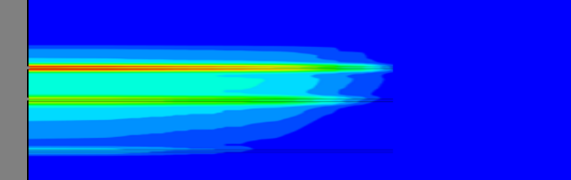


FRACTURA
Hydraulic fracturing simulation toolkit
CSIRO ENERGY

Slide 44
Thank you
DR. Xi Zhang (xi.zhang@csiro.au)
Onshore Gas program

